Slide 1
Fairness and Algorithmic Bias
Urban Analytics Summer School
2019

Slide 2
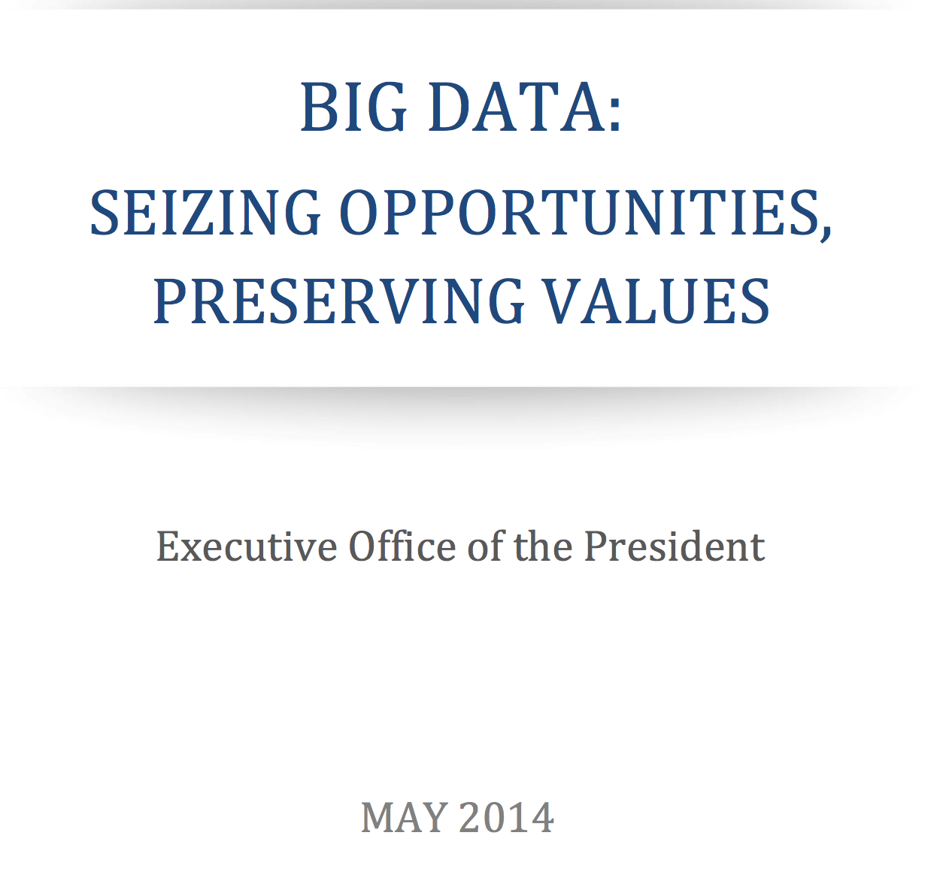
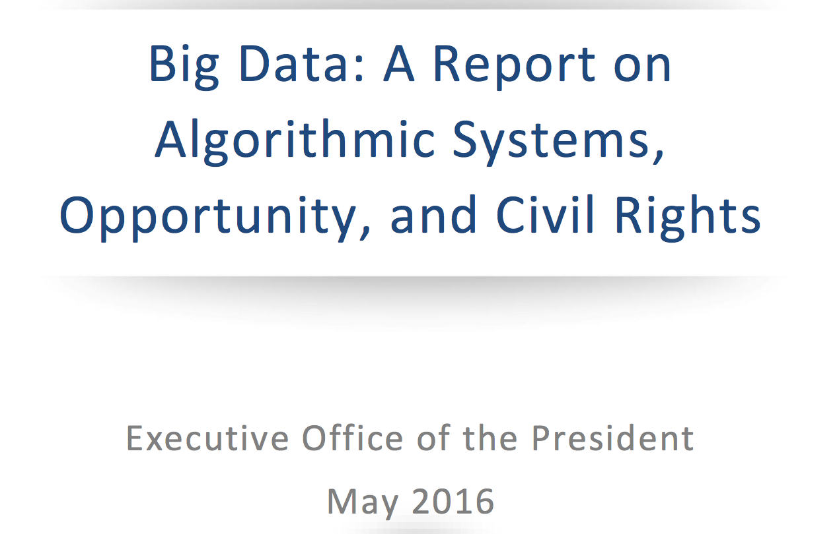
Notes:
Following a 2014 report entitled “Big Data: Seizing Opportunities, Preserving Values”

Slide 3

Legal definitions of discrimination
Disparate treatment is the illegal practice of treating an entity, such as a creditor or employer, differently based on a protected characteristic such as race, gender, age, religion, sexual orientation, or national origin.
Disparate impact is the result of systematic disparate treatment, where disproportionate adverse impact is observed on members of a protected class.
about intent
http://www.allenovery.com/publications/en-gb/Pages/Protected-characteristics-and-the-perception-reality-gap.aspx
about consequences
slide src: Julia Stoyanovich
Notes:
More formal definition; cite laws, 80% rule, statistical significance.

Slide 4

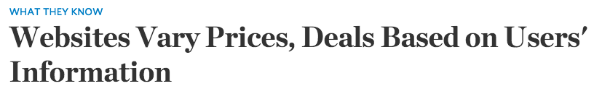
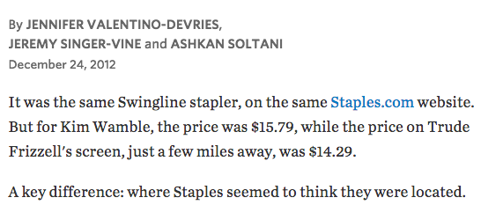
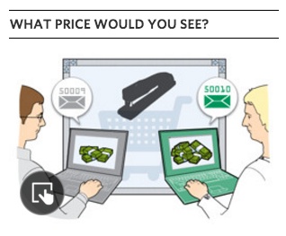
Ex: Staples online pricing
Reasoning: Offer deals to people that live near competitors’ stores
Effect: lower prices offered to buyers who live in more affluent neighborhoods
Notes:
From WLJ article:
A Wall Street Journal investigation found that the Staples Inc. website displays different prices to people after estimating their locations. More than that, Staples appeared to consider the person's distance from a rival brick-and-mortar store, either OfficeMax Inc. or Office Depot Inc. If rival stores were within 20 miles or so, Staples.com usually showed a discounted price.
In what appears to be an unintended side effect of Staples' pricing methods—likely a function of retail competition with its rivals—the Journal's testing also showed that areas that tended to see the discounted prices had a higher average income than areas that tended to see higher prices.

Slide 5
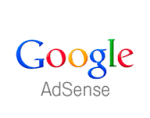
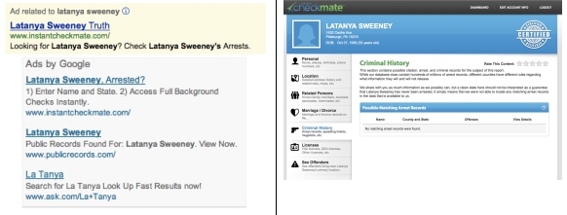
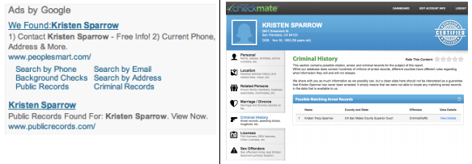
Racially identifying names trigger ads suggestive of an arrest record
[Latanya Sweeney; CACM 2013]
slide adapted from Stoyanovich, Miklau
Notes:
Users and regulators must be able to understand how raw data was selected, and what operations were performed during analysis
Users want to control what is recorded about them and how that information is used
Users must be able to access their own information and correct any errors (US Fair Credit Reporting Act)
Transparency facilitates accountability - verifying that a service performs as it should, and that data is used according to contract

Slide 6
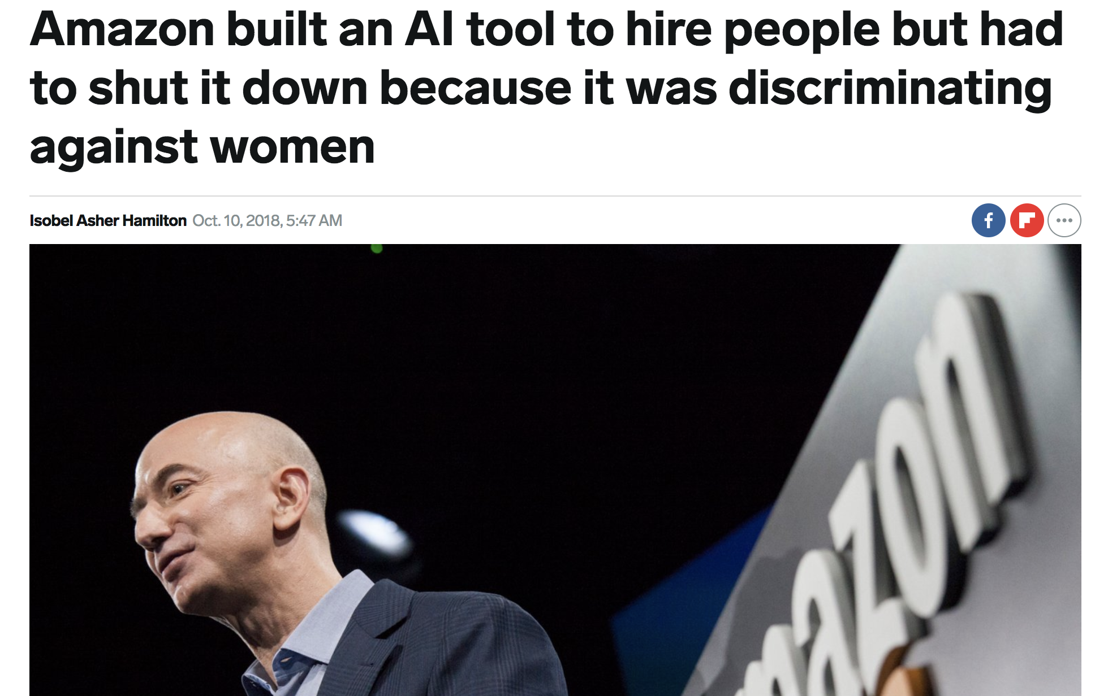

Slide 7
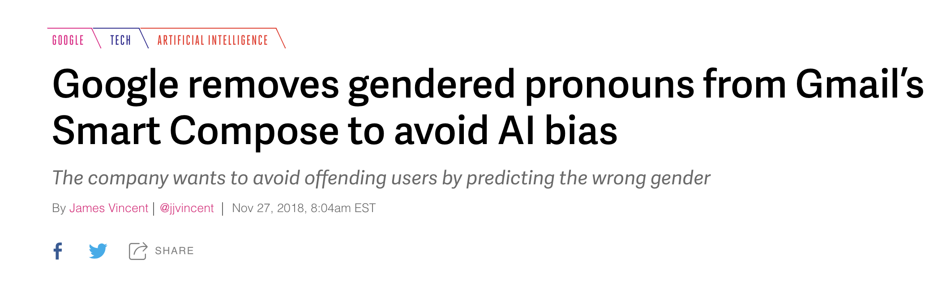

Slide 8
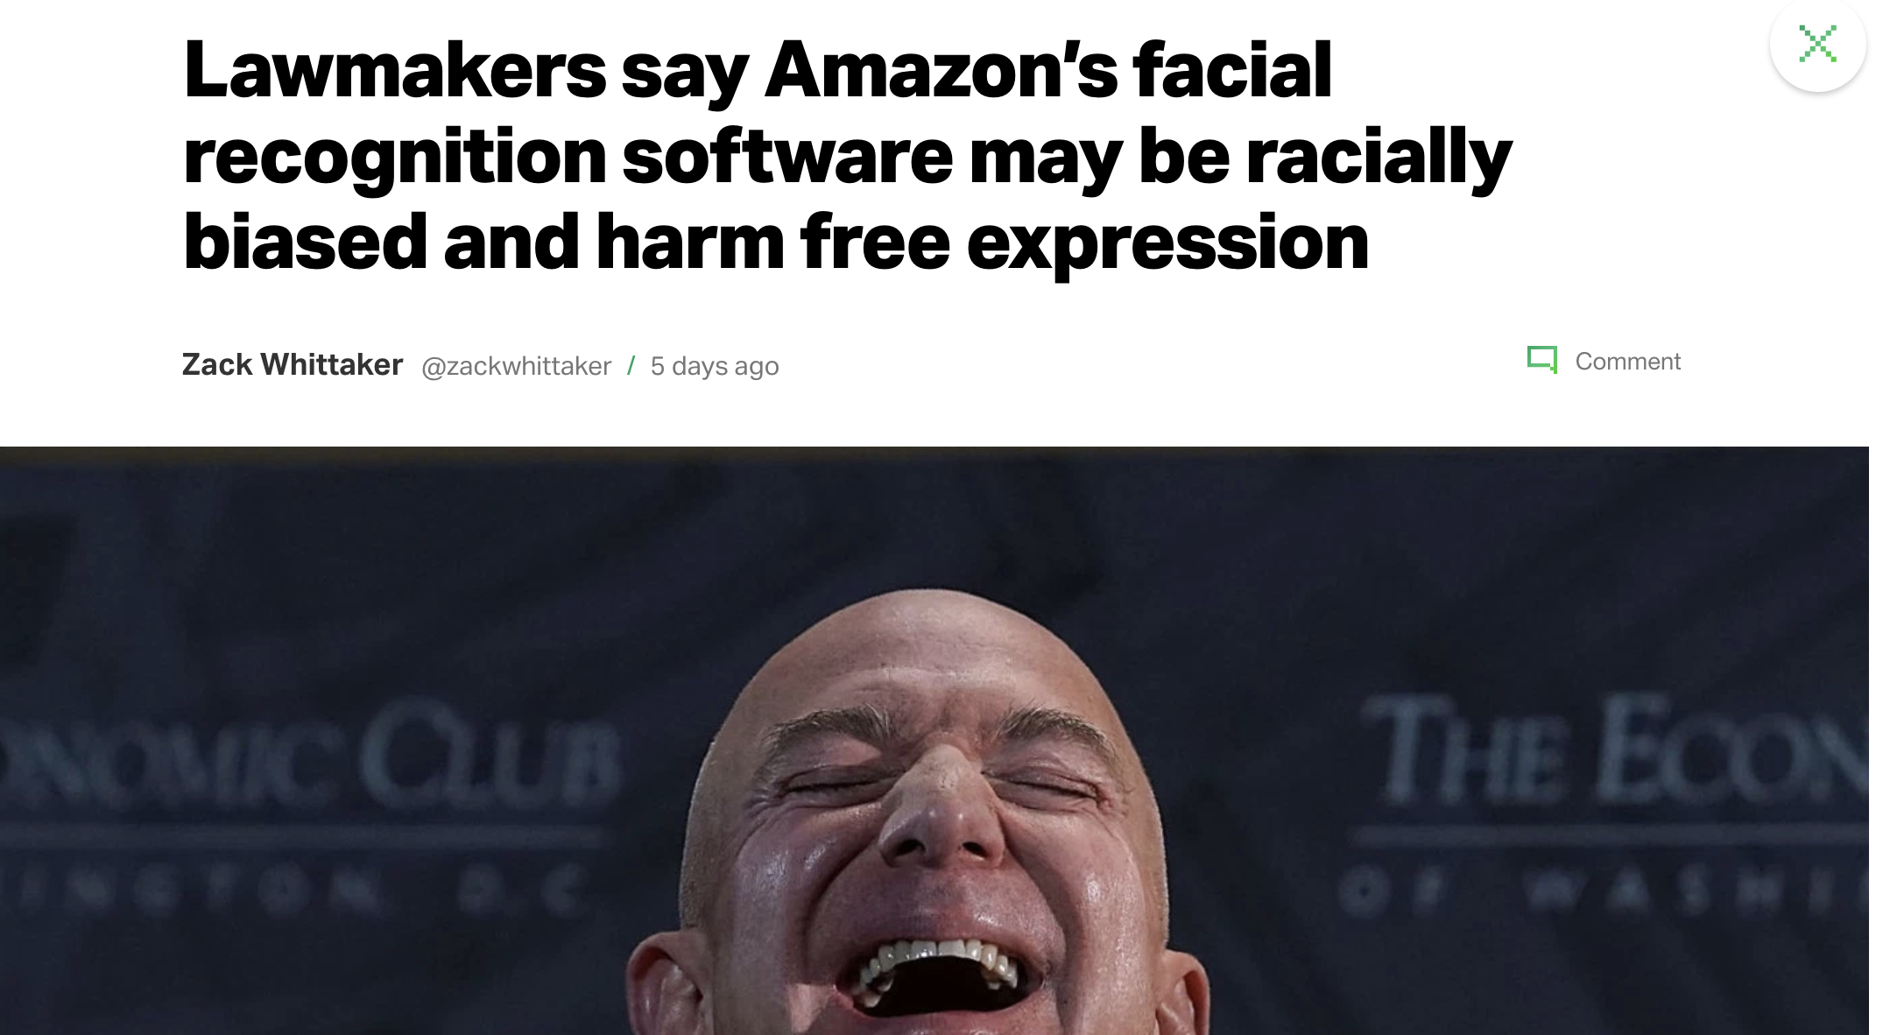

Slide 9
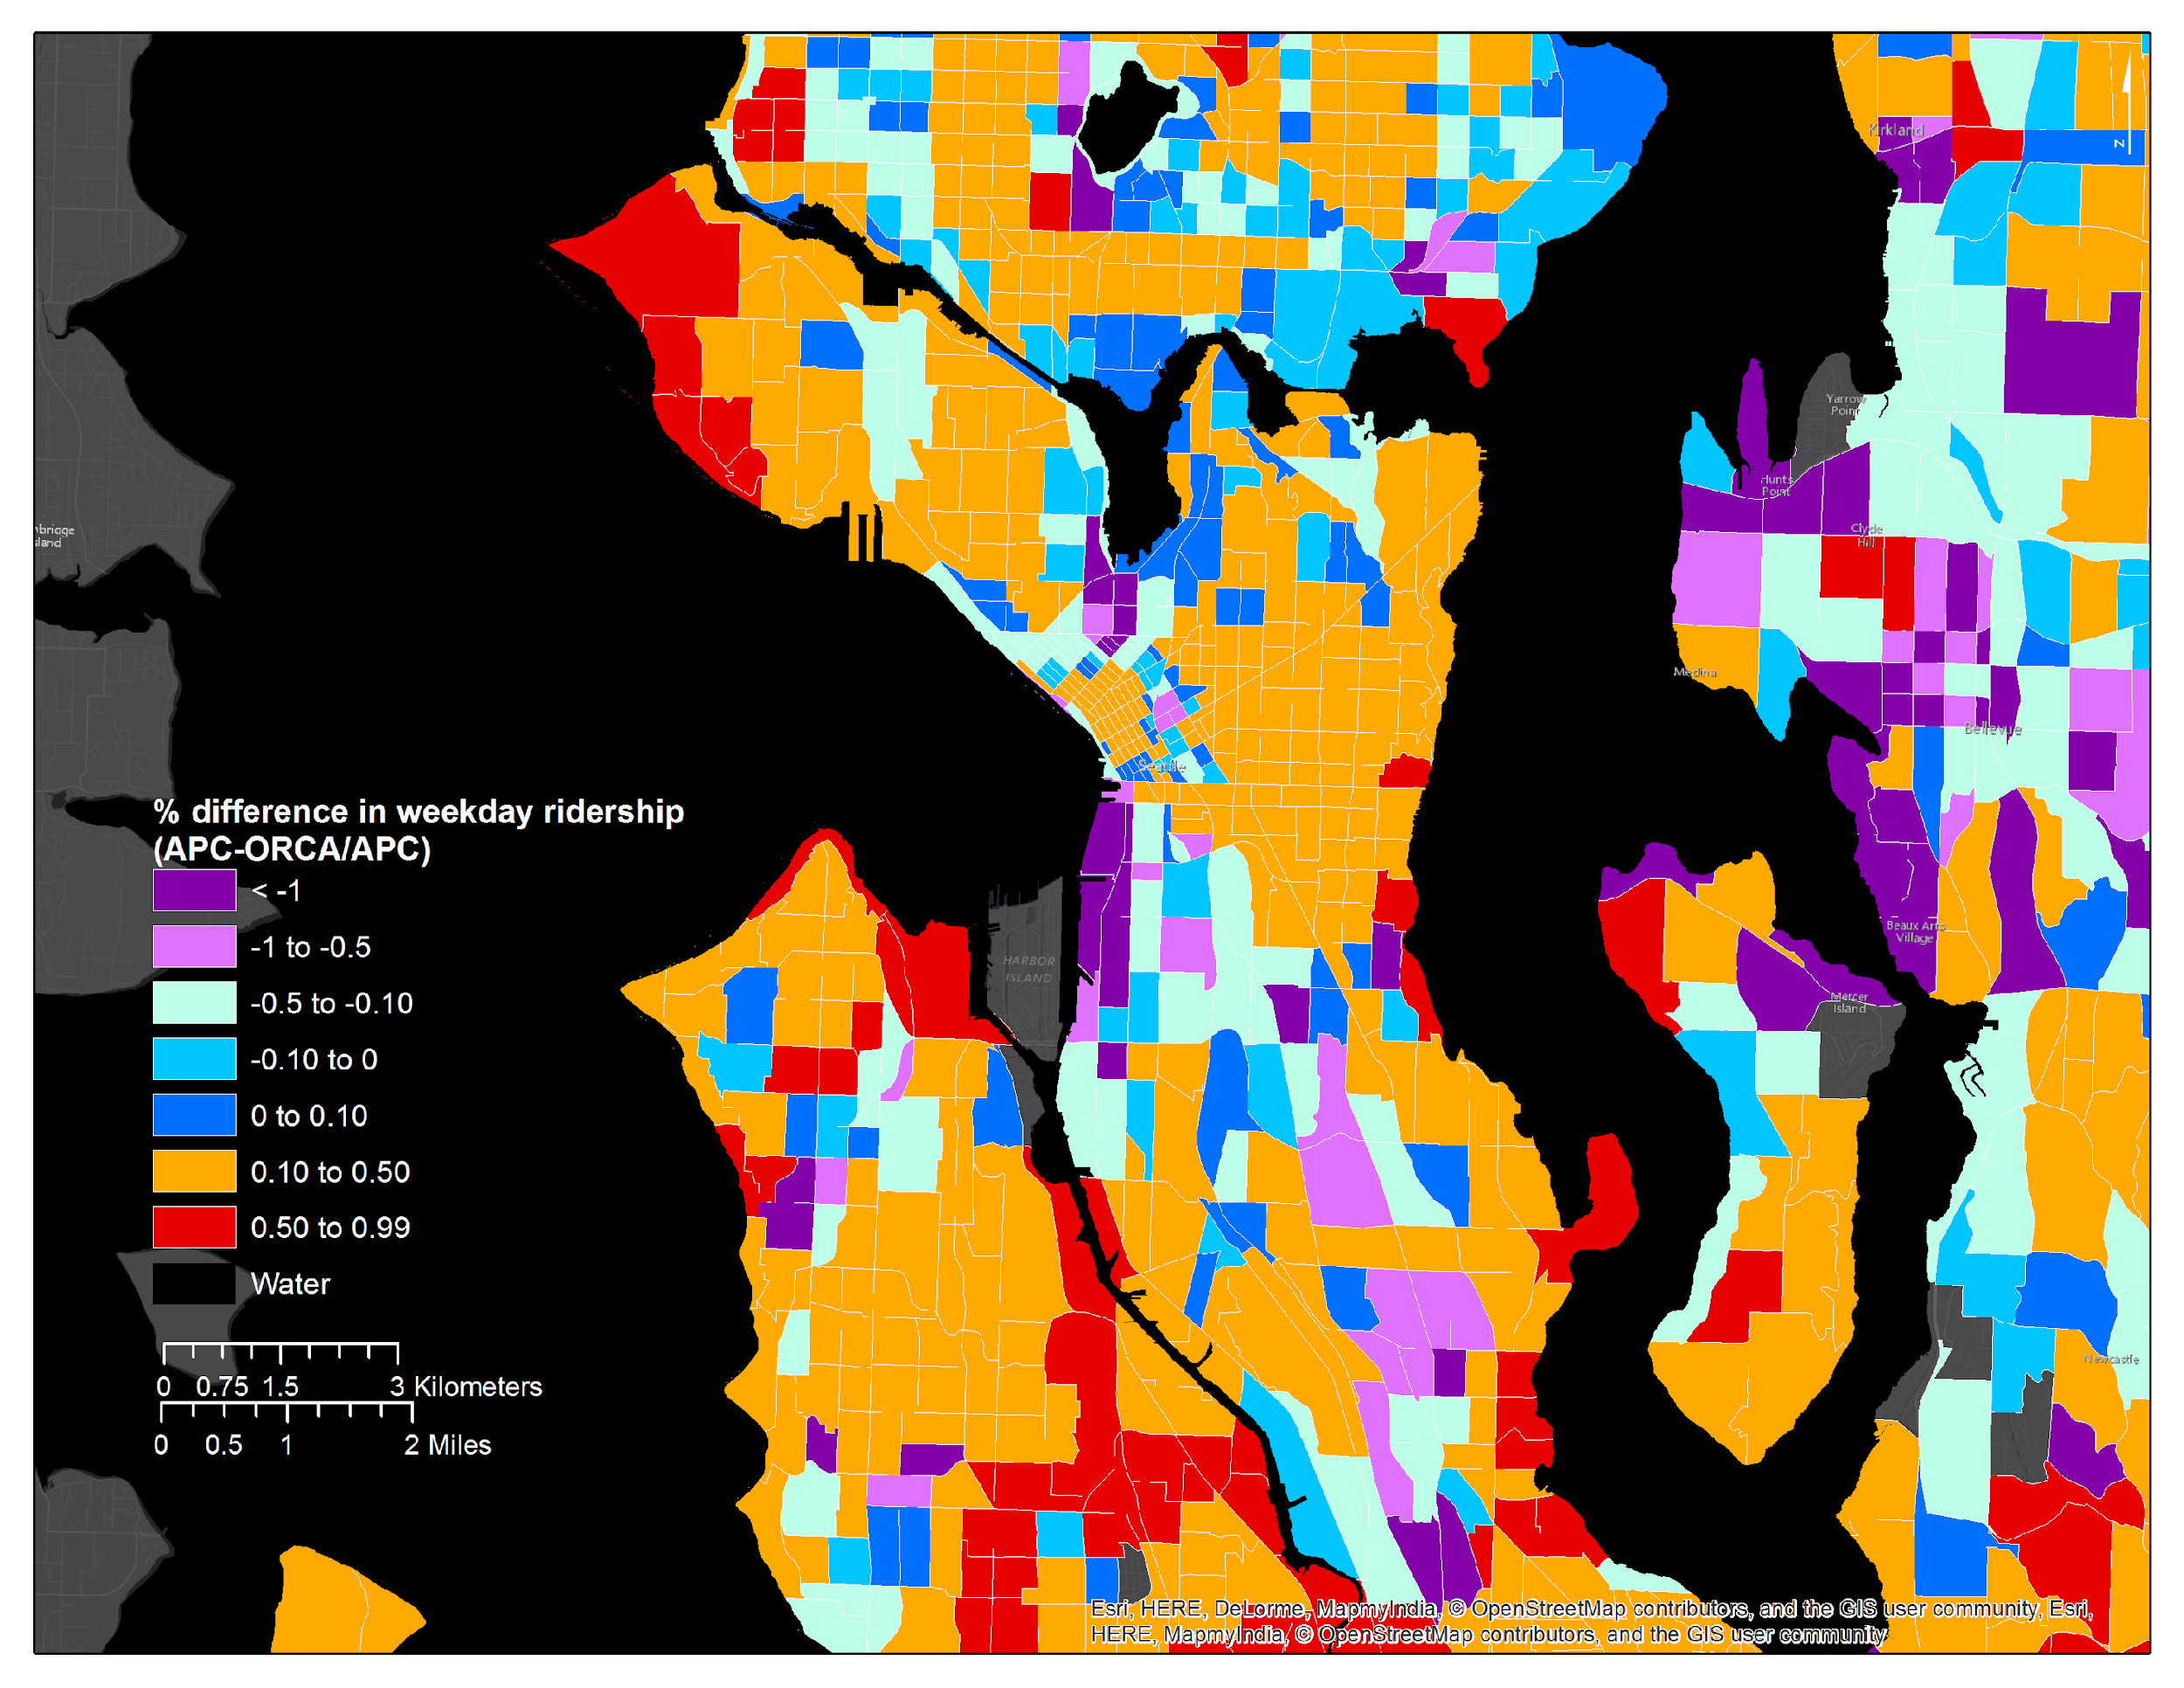

ORCA Percentage Difference in Ridership, Seattle
Mark Hallenbeck
TRAC

Slide 10
Google Translate swaps gender pronouns due to biased data
Notes:
Google’s language translation swaps pronouns for professions with historical gender bias

Slide 11
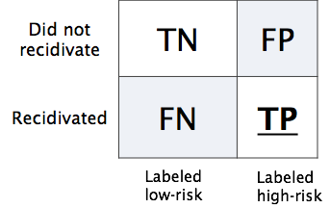
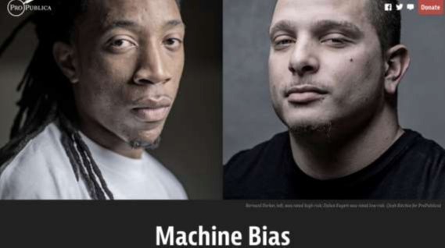
Propublica, May 2016
Predictive Parity: same positive outcome rates across groups, given predictions
Pr(high-risk | black, predicted low-risk) = Pr(high-risk | white, predicted low-risk)
Pr(high-risk | black, predicted high-risk) = Pr(high-risk | white, predicted high-risk)
Equalized Odds: same FP between groups
Pr(predicted high risk | black, low-risk) = Pr(predicted high-risk | white, low-risk)
These are mutually exclusive [Chouldechova 2017]
“21 different fairness metrics, implies hundreds of impossibility theorems”
[Narayanan 2018]
23
Notes:
the Equalized Odds and Predictive Parity are impossible to achieve simultaneously when prevalence of the two populations di ers, meaning Pr(Y = 1|S = 0) Pr(Y = 1|S = 1).

Slide 12
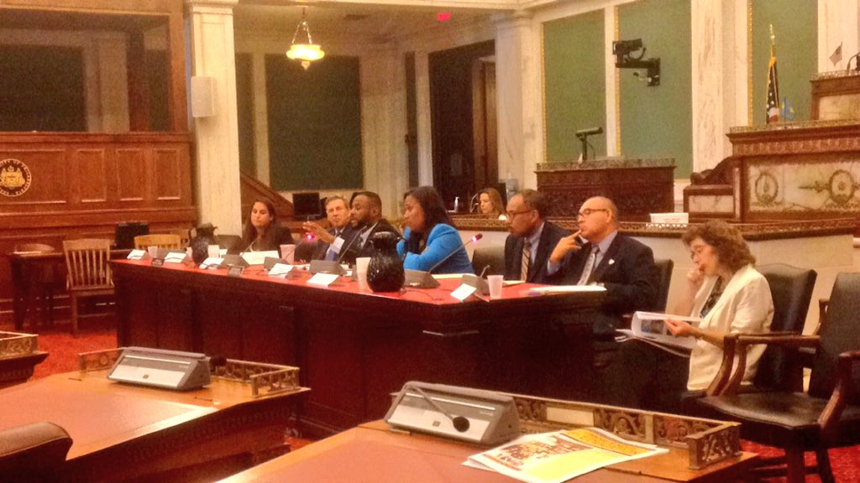
Philadelphia is grappling with the prospect of a racist computer algorithm
Technical.ly, September 2016
“Should I be afraid of risk assessment tools?”
“No, you gotta tell me a lot more about yourself.
At what age were you first arrested?
What is the date of your most recent crime?”
“And what’s the culture of policing in the neighborhood in which I grew up in?”
Any background signal in the data of institutional racism is
amplified by the algorithm
operationalized by the algorithm
legitimized by the algorithm
The Special Committee on Criminal Justice Reform's hearing of reducing the pre-trial jail population.
Notes:
LSI-R model
25 states use it
Most for targeted programs
Idaho and Colorado use this for sentencing
“As a Black male,” Cobb asked Penn statistician and resident expert Richard Berk, “should I be afraid of risk assessment tools?”
“No,” Berk said, without skipping a beat. “You gotta tell me a lot more about yourself. … At what age were you first arrested? What is the date of your most recent crime? What are you charged with?”
Cobb interjected: “And what’s the culture of policing in the neighborhood in which I grew up in?”
(emphasis mine)
That's exactly the point (and to Michael -- this is what I was arguing about with the guy from Comcast): a little bit of institutional racism has a triple effect:
a) institutional racism is amplified by the algorithm (a small signal can now dominate the model)
b) institutional racism is operationalized by the algorithm (it's far easier now to make impactful decisions based on bad data)
c) institutional racism is legitimized by the algorithm (so that everyone thinks "it's just data" and actively defends the algorithm's assumed objectivity, even when the racist results are staring you right in the face. This vigorous defense doesn't happen when a human is shown to be correlating their decisions perfectly with race.)

Slide 13
Algorithmic Fairness
ML algorithms influence decisions affecting people in tasks ranging from helping banks to determine the creditworthiness of customers to suggesting a likelihood that a criminal will reoffend
How can we ensure that our algorithms act in ways that do not reinforce systemic discrimination?
Notes:
Today, algorithms are harnessing volumes of macro- and micro-data to influence decisions affecting people in a range of tasks, from helping banks determine the creditworthiness of individuals, and in scoring how likely a criminal will commit another crime in the future, which influences the severity of sentencing.
How can we ensure that our algorithms act in ways that are fair or not biased? (as opposed to human)
There is no generally accepted definition of bias. But many existing definition tries to capture the following intuition
“bias”: a term that we define broadly as it relates to outcomes which are systematically less favorable to individuals within a particular group and where there is no relevant difference between groups that justifies such harms.

Slide 14
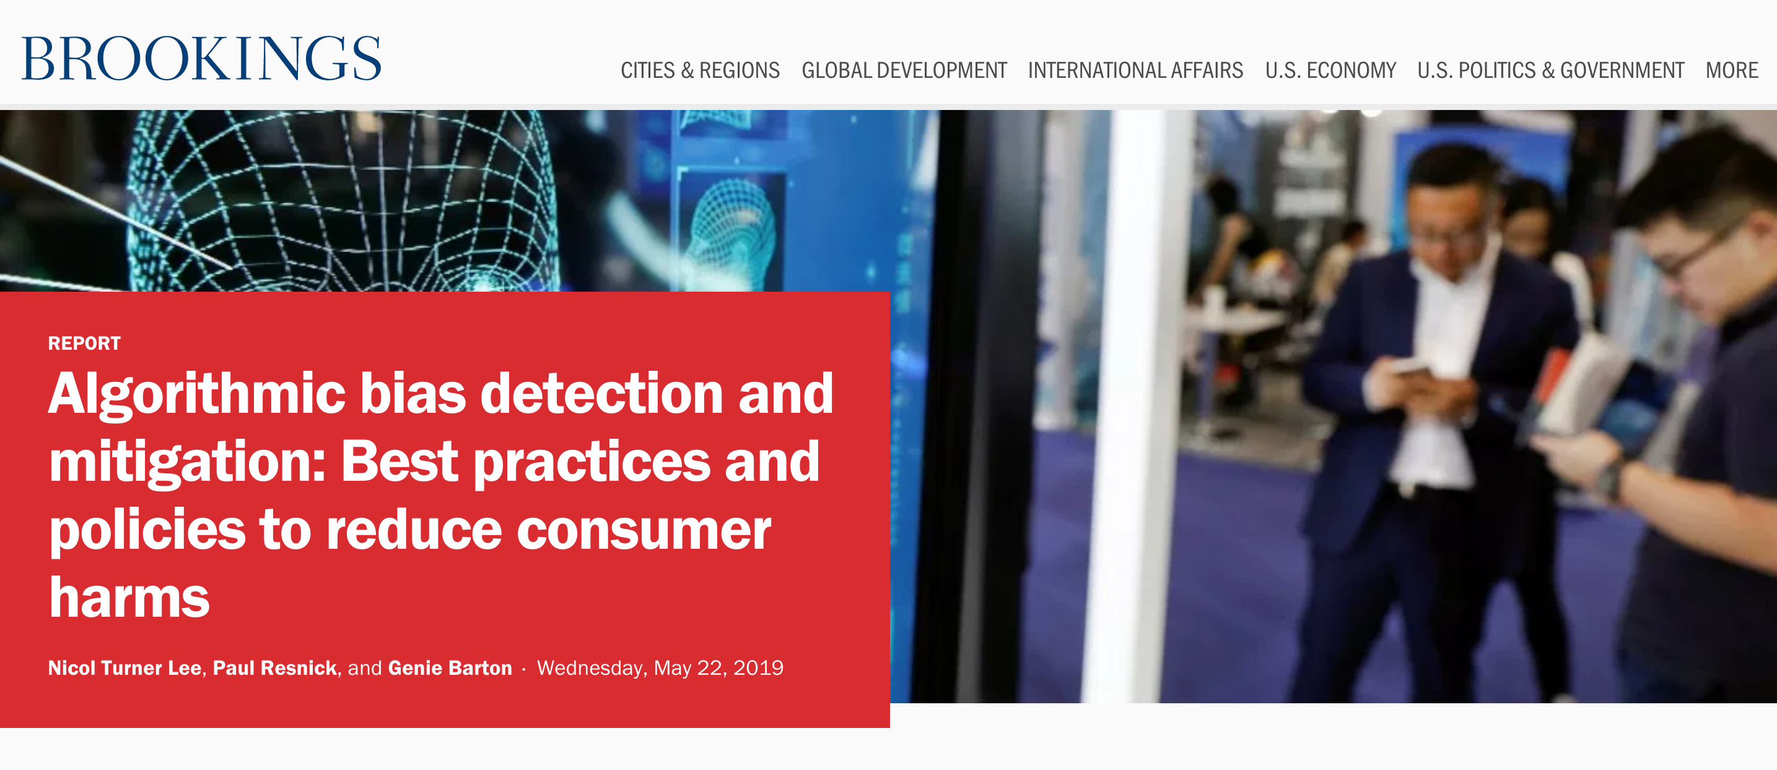

“bias, a term that we define broadly as it relates to outcomes which are systematically less favorable to individuals within a particular group and where there is no relevant difference between groups that justifies such harms”
Notes:
This is one of favorite broad definition of bias. Many of the existing definitions including what capuchin proposes in this talk meant to capture this intuition.

Slide 15

Problem setup (1): Outcomes
Consider a vendor assigning positive or negative
outcomes to individuals.
Positive Outcomes | Negative Outcomes
offered employment | denied employment
accepted to school | rejected from school
offered a loan | denied a loan
offered a discount | not offered a discount

Slide 16
Problem setup (2): Assigning outcomes to populations
Fairness is concerned with how outcomes are assigned to a population
positive outcomes
40% of the population
◦
◦
◦
◦
◦
◦
⊕
⊕
⊖
◦
◦
◦
⊖
◦
⊖
◦
◦
⊖
◦
◦
⊕
◦
◦
⊕
◦
◦
⊖
◦
◦
⊖
Population
Assignments
Individual with
negative outcome
Individual with
positive outcome

Slide 17
Sub-populations may be treated differently
Sub-population: those with red hair
(under the same assignment of outcomes)
positive
outcomes
40% of the whole population
hair color | red
 | not red
20%
of red
haired
disparate
impact
on red-haired
people
⊕
⊖
⊖
⊖
⊖
}
⊖
⊕
60%
of not red
haired
statistical
parity
fails
⊕
⊕
⊖
Notes:
Disparate impact in US is measured by comparing the rate of positive outcomes for the protected class (here 20%, assuming red-hairs are protected) divided by rate of positive outcomes for the population as a whole.
It that ratio is less than 80%, it is considered discriminatory (or potentially discriminatory).

Slide 18
First attempt: Enforcing statistical parity
Statistical parity (aka group fairness)
demographics of the individuals receiving any outcome are the same as demographics of the underlying population
positive
outcomes
40% of the whole population
hair color | red
 | not red
40%
of red
haired
⊕
⊖
⊖
⊖
⊕
⊖
⊖
40%
of not red
haired
⊕
⊕
⊖

Slide 19
Redundant encoding
Now consider the assignments under both
hair color (protected) and hair length (innocuous)
 |  | hair length
 |  | long | not long
hair color | red
 | not red
positive
outcomes
⊖
⊖
20%
of red
haired
⊕
⊖
⊖
60%
of not red
haired
⊕
⊕
⊖
⊕
⊖
Deniability
The vendor has adversely impacted red-haired people, but could claim that outcomes are assigned according to hair length.
Notes:
Because of redundant encoding, adverse impact to sub-population may be “deniable” or “unintended”

Slide 20
Blinding does not imply fairness
Removing hair color from the vendor’s assignment process does not prevent disparate impact
 |  | hair length
 |  | long | not long
hair color | red
 | not red
positive
outcomes
⊖
⊖
20%
of red
haired
⊕
⊖
⊖
60%
of not red
haired
⊕
⊕
⊖
⊕
⊖
Assessing disparate impact
Discrimination is assessed by the effect on the protected sub-population, not by the input or by the process that lead to the effect.
Notes:
The same example of redundant encoding shows why blinding does not imply fairness.

Slide 21
Redundant encoding
Let’s replace hair color with race (protected),
hair length with zip code (innocuous)
 |  | zip code
 |  | 10025 | 10027
race | black
 | white
positive
outcomes
⊖
⊖
20%
of black
⊕
⊖
⊖
60%
of white
⊕
⊕
⊖
⊕
⊖
Notes:
Redundant encoding was actually used to disguise discrimination: red lining

Slide 22
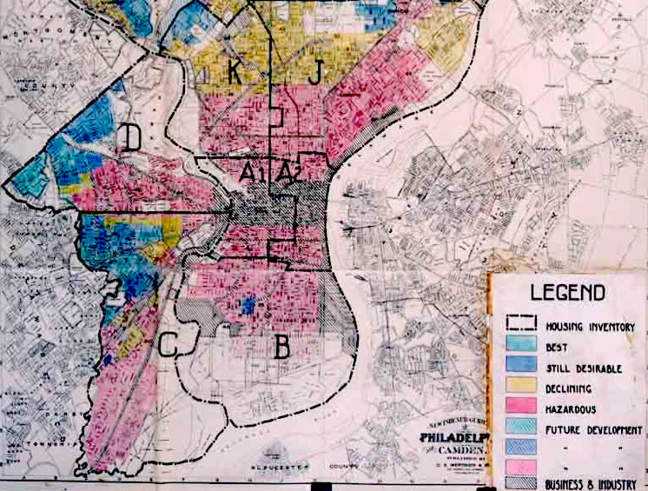
Discrimination
Redlining is the practice of arbitrarily denying or limiting financial services to specific neighborhoods, generally because its residents are people of color or are poor.
Philadelphia, 1936
Households and businesses in the red zones could not get mortgages or business loans.
wikipedia

Slide 23
Discrimination may be unintended
Staples website estimated user’s location, offering discounts to those near rival stores, leading to discrimination w.r.t. to average income.
 |  | rival store proximity
 |  | close | far
 | low
 | high
positive
outcomes
⊖
⊖
20%
of low income
⊕
⊖
⊖
income
60%
of high income
⊕
⊕
⊖
⊕
⊖
Discrimination
Whether intentional or not, discrimination violates disparate impact, which in many situations is not only an ethical standard, but a legal one
Notes:
Notice that this is also the source of the Staples example…

Slide 24
Simpson’s Paradox: Effect on subpopulations
Simpson’s paradox
Disparate impact at the full population level disappears or reverses when looking at subpopulations!
 |  | grad school admissions
 |  | admitted | denied
 | F | 1512 | 2809
 | M | 3715 | 4727
positive
outcomes
35%
of women
gender
44%
of men
UC Berkeley 1973: women applied to more competitive departments, with low rates of admission among qualified applicants.
Notes:
The point here is that avoiding discrimination may be directly in conflict with the vendor (or classifier’s) utility goals. It is therefore a constraint on the assignment of outcomes that must be balanced with the vendor’s interests.
In reality, it is impossible to predict loan payback accurately, so we use past information. Then the question arises whether that past information is biased.

Slide 25
Is statistical parity sufficient?
Statistical parity (aka group fairness)
demographics of the individuals receiving any outcome are the same as demographics of the underlying population
 |  | credit score
 |  | good | bad
 | black
 | white
positive
outcomes
offered
credit
⊖
⊖
40%
of black
⊕
⊕
⊖
race
40%
of white
⊕
⊖
⊖
⊕
⊖
Individual fairness (Dwork)
any two individuals who are similar w.r.t. a particular task should receive similar outcomes.
But: Ignores the protected status of certain groups subject to institutionalized historical discrimination, which can influence *any* data collected about them.
Notes:
This is the example where stat. parity is imposed.
It leads to a decrease in utility for the vendor (because they are required to offer a positive outcome to a bad credit risk).
But it also hurts individual fairness: two individuals both with good credit, but one is denied a positive outcome.

Slide 26

How do we quantify discrimination?
positive
outcomes
40% of the whole population
hair color | red
 | not red
20%
of red
hair
⊕
⊖
⊖
⊖
⊖
⊖
⊕
60%
of not red
hair
⊕
⊕
⊖
discrete (binary) protected feature S
X⁺ are members of X with S=1
X⁻ are members of X with S=0

Slide 27
Discrimination Criteria
[Indre Zliobaite, CoRR abs/1511.00148 (2015)]
Statistical tests check how likely the difference between groups is due to chance - is there discrimination?
Absolute measures express the absolute difference between groups, quantifying the magnitude of discrimination
Conditional measures express how much of the difference between groups cannot be explained by other attributes, also quantifying the magnitude of discrimination
Structural measures how wide-spread is discrimination? Think Simpson’s paradox, individual fairness.

Slide 28
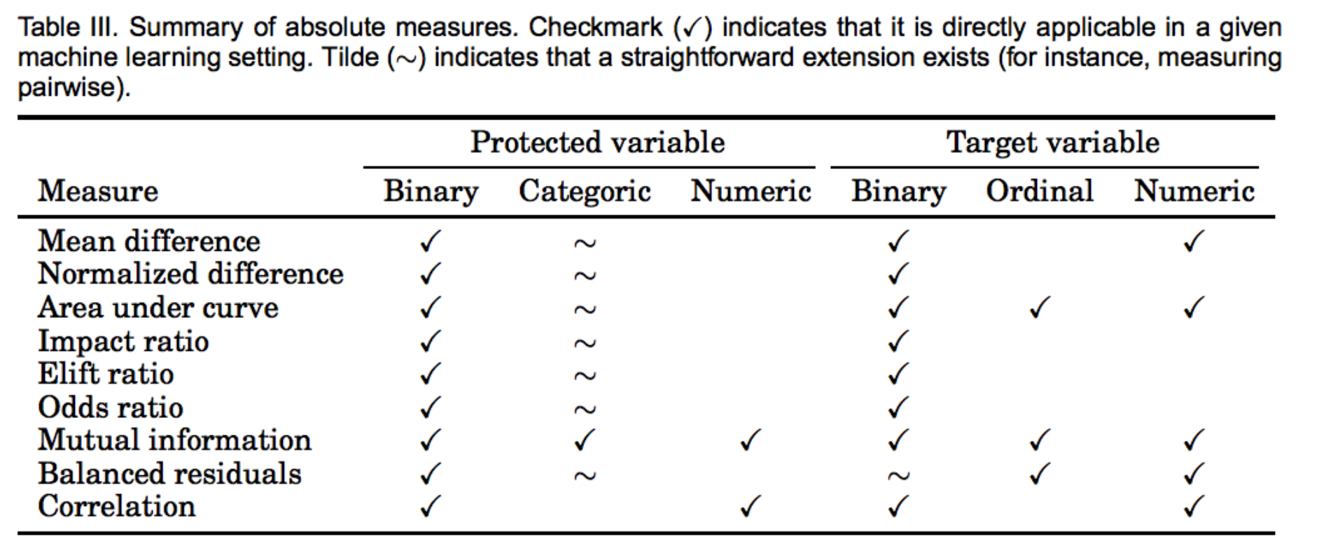
Discrimination Criteria
[Indre Zliobaite, CoRR abs/1511.00148 (2015)]

Slide 29
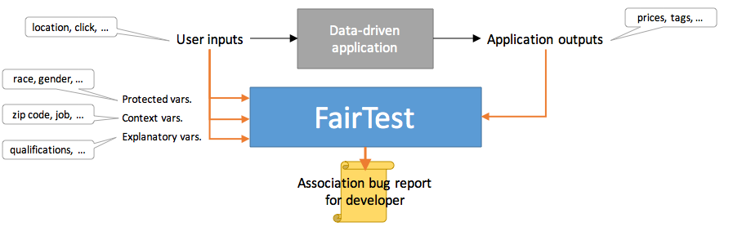
A systems approach: FairTest: fairness test suite for data analysis apps
[F. Tramèr et al., arXiv:1510.02377 (2015)]
Tests for unintentional discrimination according to several representative discrimination measures.
Automates search for context-specific associations between protected variables and application outputs
Report findings, ranked by association strength and affected population size

Slide 30
A systems approach: FairTest: fairness test suite for data analysis apps
[F. Tramèr et al., arXiv:1510.02377 (2015)]
Binary ratio / difference compares probabilities of a single output for two groups
Easy to extend to non-binary outputs, not easy to overcome binary protected class membership
Pr(Y =1 | X⁺) − Pr(Y = 1 | X⁻)
Pr(Y = 1 | X⁺)
Pr(Y = 1 | X⁻ )
- 1
Mutual information measures statistical dependence between outcomes and protected group membership
Pr(y, s)
Pr(y)Pr(s)
Σ Pr(y, s) ln
Works for non-binary outputs, class membership, can be normalized; bad for continuous values, does not incorporate of order among values

Slide 31
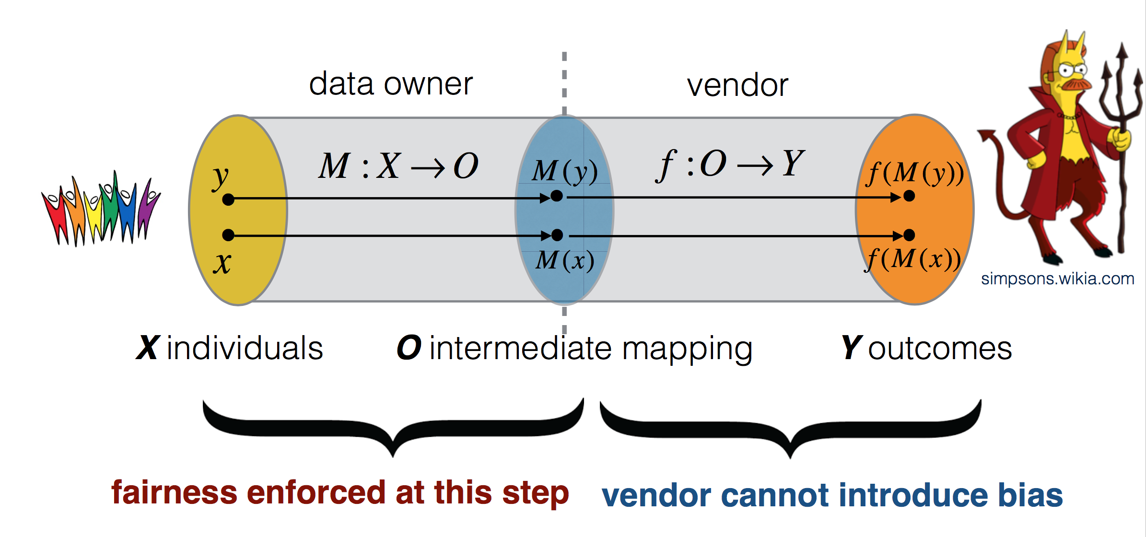
Finding Fair Representations
[C. Dwork, M. Hardt, T. Pitassi, O. Reingold, R. S. Zemel; ITCS 2012]

Slide 32
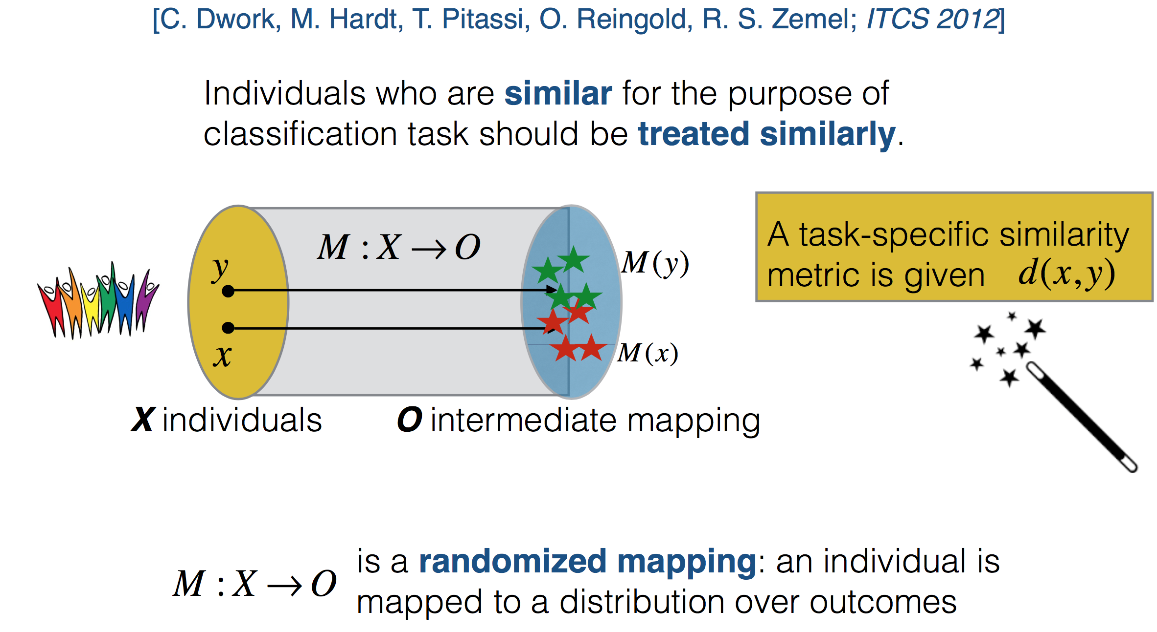
Task-specific Fairness

Slide 33
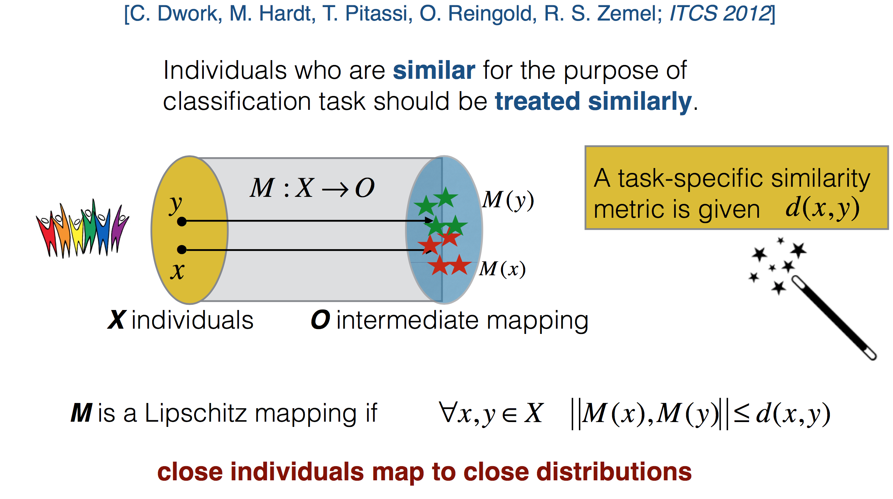
Fairness through a Lipschitz mapping

Slide 34
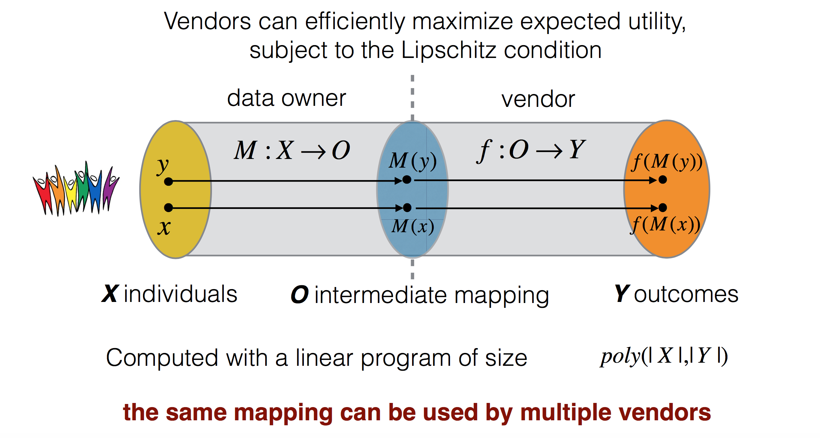
What about the vendor?
[C. Dwork, M. Hardt, T. Pitassi, O. Reingold, R. S. Zemel; ITCS 2012]

Slide 35
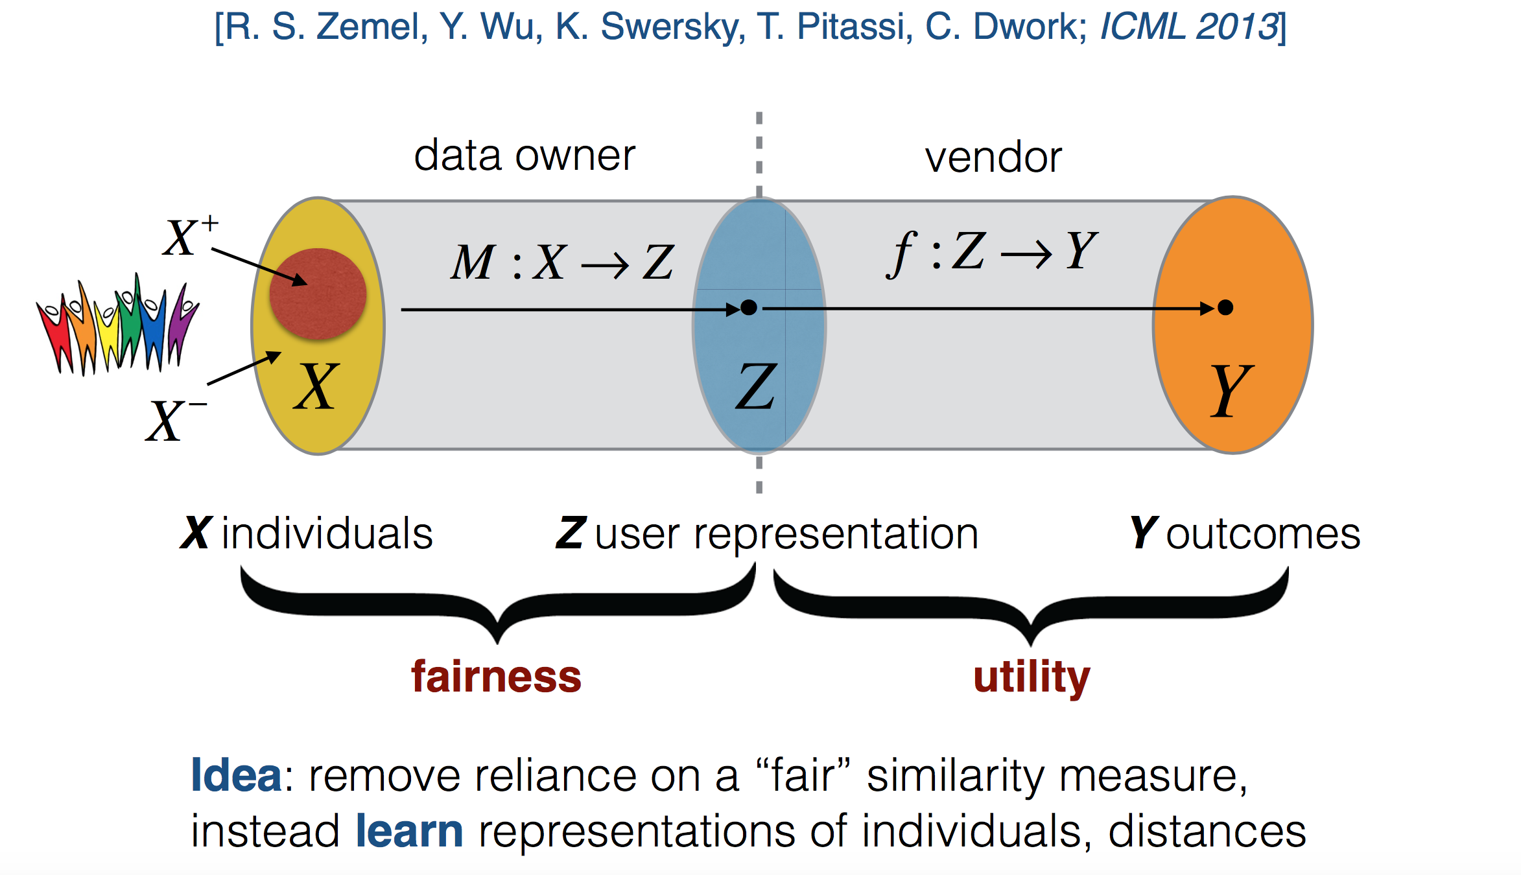
Learning Fair Representations

Slide 36
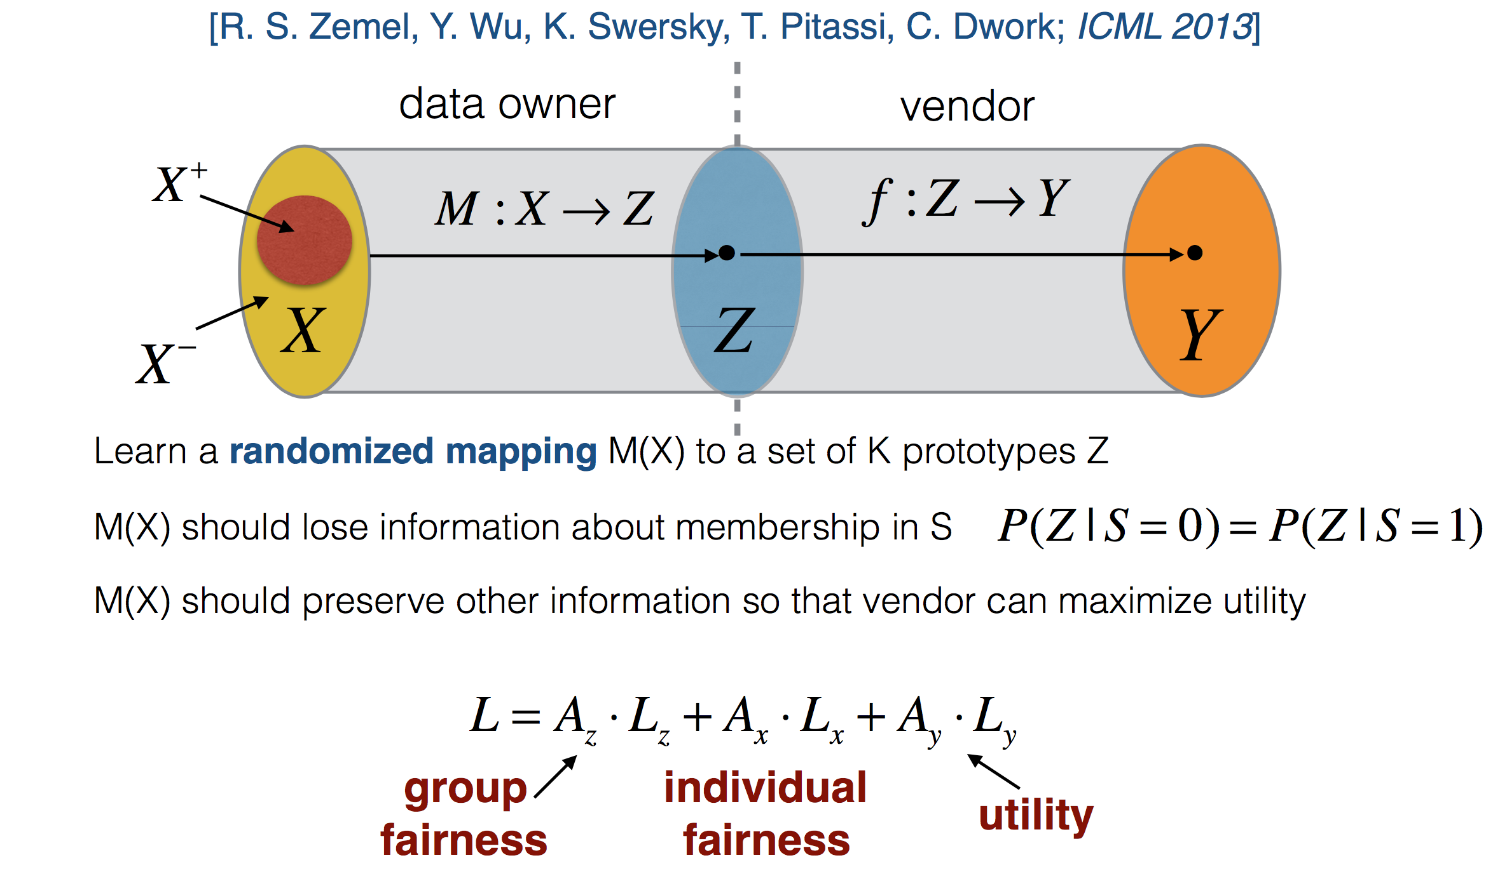
Fairness and Utility

Slide 37
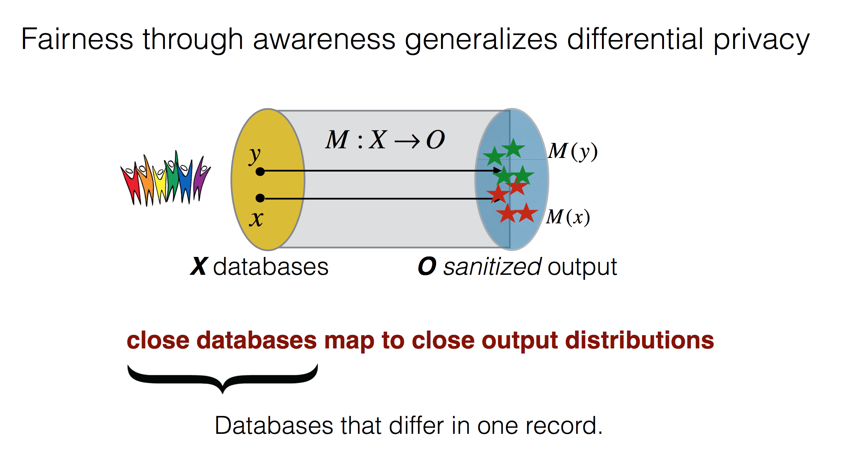
Connection to Privacy

Slide 38
RepairinG for BIAs, and causality-based methods

Slide 39
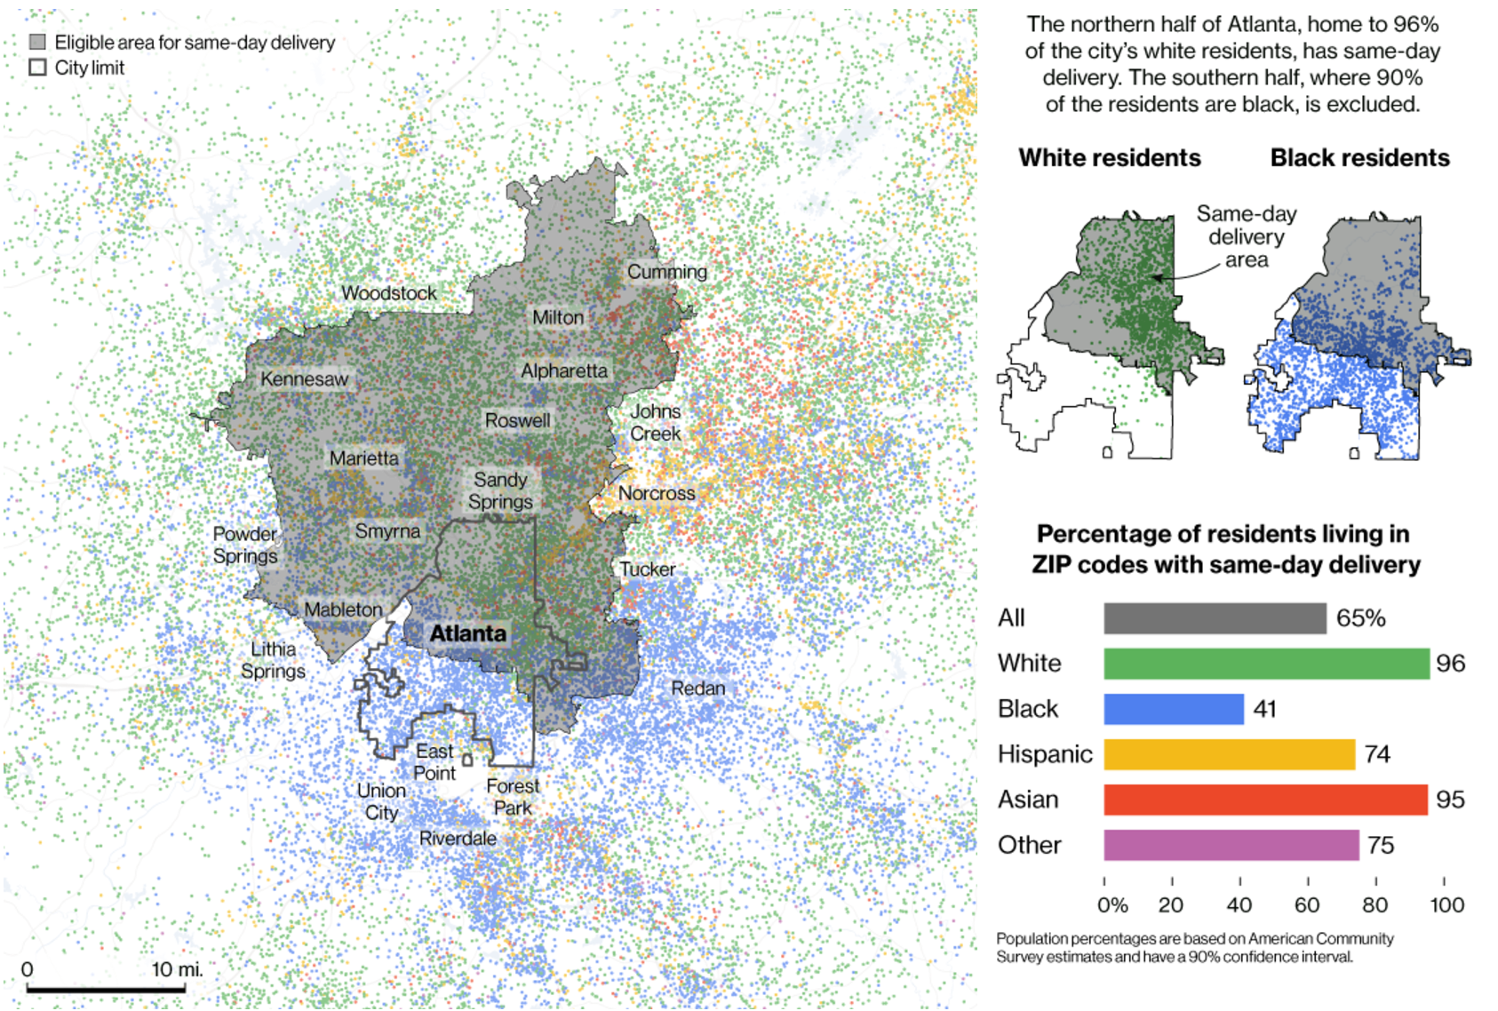
Amazon Prime Now Delivery Area: Atlanta
Bloomberg, 2016
Notes:
Let me give you an example.
Bloomberg wrote a piece in 2016 about the Amazon prime now delivery area. They trained a model to decide who to offer the service to, considering buying history, income, location. They did not consider race.
This is a map of Atlanta. I grew up in Atlanta. You can see that everyone in the north half received the discount and no one in the south half did. What else is true about the north half of Atlanta vs. the south half?

Slide 40
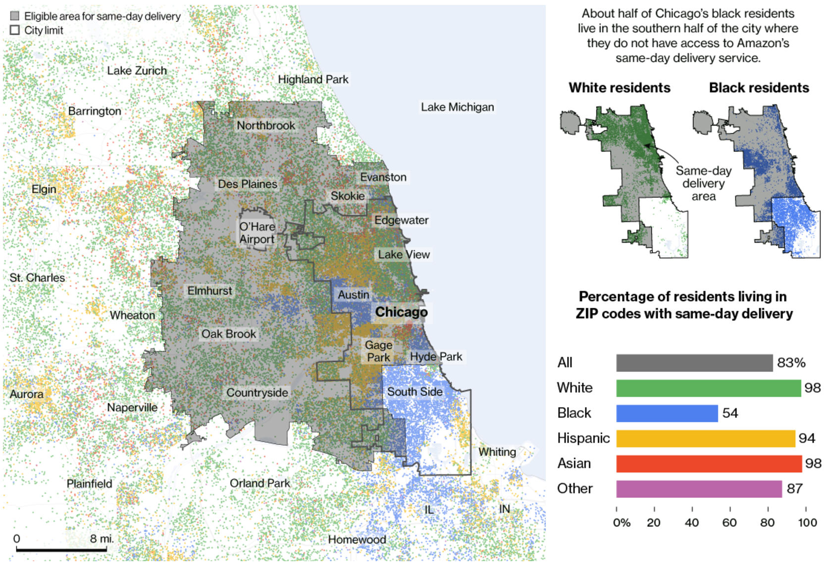
Amazon Prime Now Delivery Area: Chicago
Bloomberg, 2016
Notes:
It gets worse. In Chicago, everyone received the service except the south side, which is predominately African American.

Slide 41
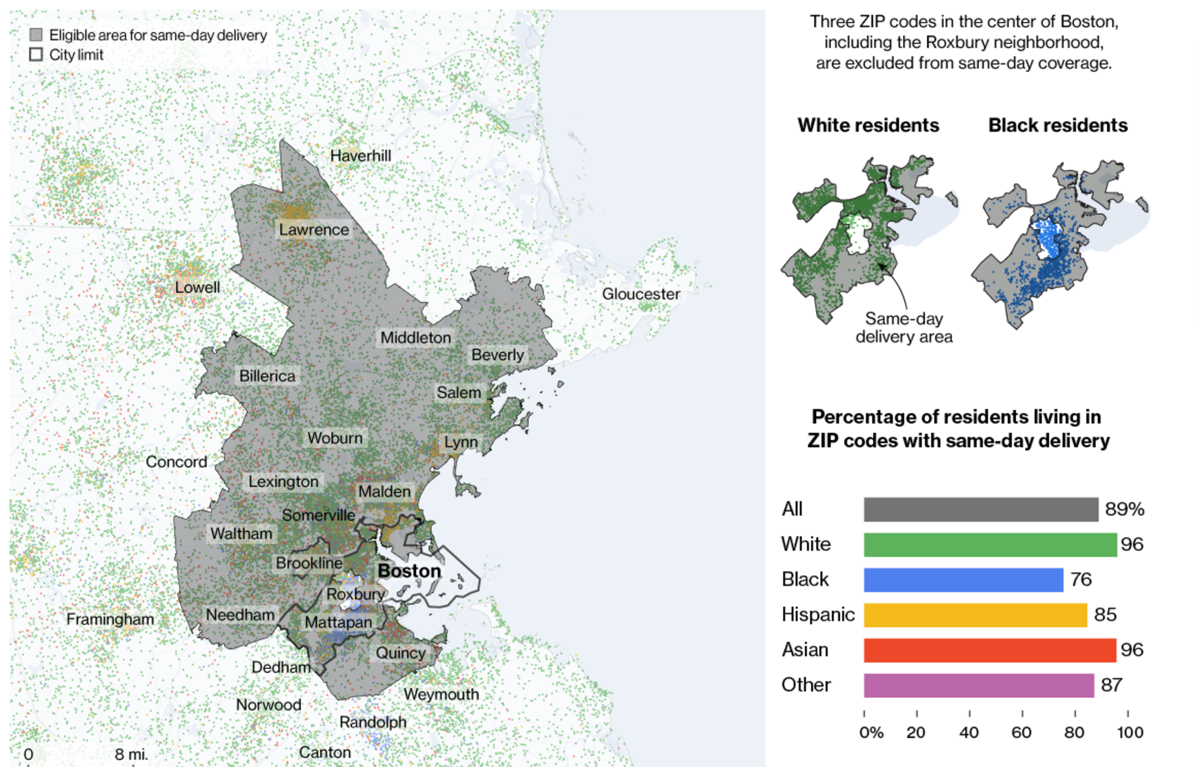
Amazon Prime Now Delivery Area: Boston
Bloomberg, 2016
Notes:
In Boston, they carved out a donut shape around Roxbury.
The HUD recently sued Facebook for this kind of digital redlining, and signaled that Twitter and Google are next.

Slide 42
redlining map of Atlanta, National Archives, 1938

Slide 43
Raw data considered harmful
Raw data is both an oxymoron and a bad idea; to the contrary, data should be cooked with care. Geoffrey Bowker (2005, p. 183-184)
Discount = f(buying history, zipcode) “We dropped race”
But zipcode = f(race), buying history = f(race)
So the raw data is misleading
Polluted by 300 years of institutionalized racism
We want data from the world we wish we had, not the world we do have
Consider the context and adjust the data prior to training models
Who has the authority to tell us what to adjust?
Data providers
Social scientists
How do we encode these adjustments?
Causality

Slide 44
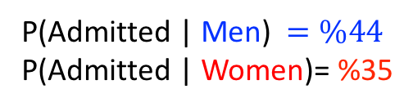
Associational Fairness: misleading
P(Admitted | Men) $=\%44$
P(Admitted | Women)= %35
[UC Berkeley 1973 grad school admissions]
Notes:
This seemingly paradoxical observation can be demystify using causal models that abstract the underling data generative process.
A BETTER tool to reason about fairness, is not associational fairness, but it is the causal model in the data.
Then explain the causal model here.
In the language of causal inference gender would indirectly effects admission result through the free will to choice different department.
An effect that that did not constitute evidence for
gender-based discrimination.

Slide 45
Associational Fairness: misleading
P(Admitted | Men) $=\%44$
P(Admitted | Women)= %35
[UC Berkeley 1973 grad school admissions]
Notes:
This seemingly paradoxical observation can be demystify using causal models that abstract the underling data generative process.
A BETTER tool to reason about fairness, is not associational fairness, but it is the causal model in the data.
Then explain the causal model here.
In the language of causal inference gender would indirectly effects admission result through the free will to choice different department.
An effect that that did not constitute evidence for
gender-based discrimination.

Slide 46
Simpson’s paradox
Notes:
Simpson’s paradox is pretty easy to handle, but all associational definitions of fairness can be subject to these statistical coincidences

Slide 47
Associational Fairness: misleading
Causal Model: Better
P(Admitted | Men) $=\%44$
P(Admitted | Women)= %35
G
D
A
Gender
Dept
Admitted
[UC Berkeley 1973 grad school admissions]
Notes:
This seemingly paradoxical observation can be demystify using causal models.
A causal diagram is a directed graph that displays causal relationships between attributes in a causalmodel. A causal diagram includes a set of variables (or nodes). Each node is connected by an arrow to one or more other nodes upon which it has a causal influence.
A BETTER tool to reason about fairness, is not associational fairness, but it is the causal model in the data.
In the language of causal inference gender would indirectly effects admission result through the free will to choice different department.
An effect that that did not constitute evidence for
gender-based discrimination.

Slide 48
Associational Fairness: misleading
Causal Model: Better
P(Admitted | Men) $=\%44$
P(Admitted | Women)= %35
G
D
A
Gender
Dept
Admitted
[UC Berkeley 1973 grad school admissions]
Notes:
This seemingly paradoxical observation can be demystify using causal models that use directed acyclic graph to abstract the
A BETTER tool to reason about fairness, is not associational fairness, but it is the causal model in the data.
Then explain the causal model here.
In the language of causal inference gender would indirectly effects admission result through the free will to choice different department.
An effect that that did not constitute evidence for
gender-based discrimination.

Slide 49
Associational Fairness definitions and Methods
Properties of data generative model (causal models)
Properties of the joint distribution (data)
 | Associational or Observational | Causal
In-processing (Modify the ML Algorithm) | Kamishima et al. (2012), Zafar et al. (2017b), Calders and Verwer (2010), Kilbertus et al. (2017), … | Russell et al. (2017), Kilbertus et al. (2017), Nabi and Shpitser (2018), …
Pre/post-processing (Modify the input/output Data) | Feldman et al. (2015), Hardt et al. (2016), Woodworth et al. (2017) Calmon et al. (2017), …
Capuchin
Notes:
The two main approaches to reduce or eliminate sources
of discrimination are summarized in Fig. 1. The most popular
is the in-processing, where the ML algorithm itself is
modified; this approach must be reimplemented for every
ML application. The alternative is to process either the training
data (pre-processing) or the output of the classifier itself
(post-processing). We advocate for the pre-processing strategy,
which is agnostic to the choice of ML algorithm and
instead interprets the problem as a database repair task.
Associational Causal
In-processing [5, 20, 21, 29, 48] [21, 29, 34]
(Modify the ML Algorithm)
Pre/post-processing [6, 13, 16, 45] Capuchin
(Modify the input/output Data) (this paper)

Slide 50
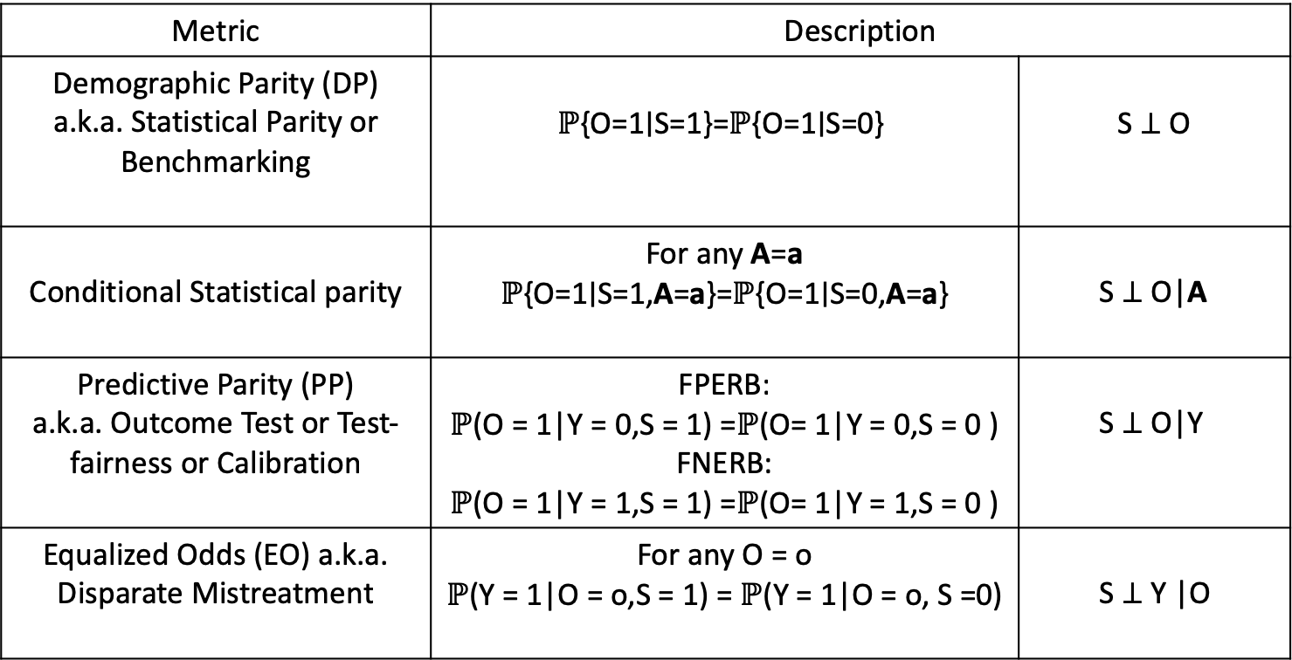
Observational Fairness Definitions
Metric | Description
Demographic Parity (DP) a.k.a. Statistical Parity or Benchmarking | $$\text{ℙ}\text{\{}\text{O}\text{=1∣}\text{S}\text{=1\}=}\text{ℙ}\text{\{}\text{O}\text{=1∣}\text{S}\text{=0\}}$$ | $$\text{S} \text{⊥} \text{O}$$
Conditional Statistical parity | For any A=a $$\text{ℙ}\text{\{}\text{O}\text{=1∣}\text{S}\text{=1,}\text{A}\text{=}\text{a}\text{\}=}\text{ℙ}\text{\{}\text{O}\text{=1∣}\text{S}\text{=0,}\text{A}\text{=}\text{a}\text{\}}$$ | S ⊥ O|A
Predictive Parity (PP) a.k.a. Outcome Test or Test-fairness or Calibration | FPERB: $\text{ℙ}$(O = 1|Y = 0,S = 1) =$\text{ℙ}$(O= 1|Y = 0,S = 0 ) FNERB: $\text{ℙ}$(O = 1|Y = 1,S = 1) =$\text{ℙ}$(O= 1|Y = 1,S = 0 ) | S ⊥ O|Y
Equalized Odds (EO) a.k.a. Disparate Mistreatment | For any O = o $\text{ℙ}$(Y = 1|O = o,S = 1) = $\text{ℙ}$(Y = 1|O = o, S =0) | S ⊥ Y |O
Notes:
During the past few years there has been an explosion of fairness definition and metric. It has been shown that some of this metrics are inconsistent.
Some people tends to believe that
These are associational or observational, i.e., they are property of the joint distribution of features, sensitive attribute and target outcome

Slide 51
Observational Fairness Definitions
Metric | Description
Demographic Parity (DP) a.k.a. Statistical Parity or Benchmarking | $$\text{ℙ}\text{\{}\text{O}\text{=1∣}\text{S}\text{=1\}=}\text{ℙ}\text{\{}\text{O}\text{=1∣}\text{S}\text{=0\}}$$ | $$\text{S} \text{⊥} \text{O}$$
Conditional Statistical parity | For any A=a $$\text{ℙ}\text{\{}\text{O}\text{=1∣}\text{S}\text{=1,}\text{A}\text{=}\text{a}\text{\}=}\text{ℙ}\text{\{}\text{O}\text{=1∣}\text{S}\text{=0,}\text{A}\text{=}\text{a}\text{\}}$$ | S ⊥ O|A
Predictive Parity (PP) a.k.a. Outcome Test or Test-fairness or Calibration | FPERB: $\text{ℙ}$(O = 1|Y = 0,S = 1) =$\text{ℙ}$(O= 1|Y = 0,S = 0 ) FNERB: $\text{ℙ}$(O = 1|Y = 1,S = 1) =$\text{ℙ}$(O= 1|Y = 1,S = 0 ) | S ⊥ O|Y
Equalized Odds (EO) a.k.a. Disparate Mistreatment | For any O = o $\text{ℙ}$(Y = 1|O = o,S = 1) = $\text{ℙ}$(Y = 1|O = o, S =0) | S ⊥ Y |O
S ⊥ O|Y
Impossibility Results
1 line proof!
S ⊥ Y
S ⊥ Y |O
Notes:
During the past few years there has been an explosion of fairness definition and metric. It has been shown that some of this metrics are inconsistent.
Some people tends to believe that
These are associational or observational, i.e., they are property of the joint distribution of features, sensitive attribute and target outcome

Slide 52
Causal Fairness
Hobbies
Qualification
Q
H
Q
G
D
A
Admitted
Gender
Dept
Notes:
Let’s create a toy example based on the Berkeley case. Suppose a collage has two department and in both of them admission decisions are made based on student’s qualification, hobby and gender!
According to that causal diagram with shows for instance, applicants gender affects their hobby bit not their qualification
Causal models for fairness have been considered in the literature. plan to spend 30' - 1 minute explaining what this means to the database person: "G, D, H,... are *attrbibutes* of the data, the data itself is not shown here. The problem of inferring the causal model from the data has been studied extensively, and it is hard and not always possible. I will assume for now that we have the causal model, later I will drop this assumption."

Slide 53
Causal Fairness
Hobbies
Qualification
Q
H
Q
G
D
A
Admitted
Gender
Dept
Fairness Definition (Attempt 1):
Arrange for no causal path from G to A
Notes:
The first approach is to forbid all causal paths from G to A. Too restrictive. This is the causal counterpart of prohibiting Statistical Parity! Which actually many ML methods does! This is too impractical.
To make it practical, we allow the user to classify variables into admissible and inadmissible. The former variables through which it is permissible for the protected
attribute to influence the outcome. In this example the user would label department as admissible since it is considered a fair use in admissions decisions, and would (implicitly) label all other variables as inadmissible, for example, hobby.

Slide 54
Causal Fairness
Hobbies
Qualification
Q
H
Q
G
D
A
Admitted
Gender
Dept
Fairness Definition (Attempt 1):
Arrange for no causal path from G to A
Problem: cannot avoid:
G→D: applicants choose their department
D→A: departments make their own decisions
Notes:
This is exactly what happened in the Berkeley data

Slide 55
Causal Fairness
Hobbies
Qualification
Q
H
Q
G
D
A
Admitted
Gender
Dept
Our solution: partition variables into:
Admissible/ Inadmissible
Notes:
To capture such subtle situation, we partition the variable into admissible and inadvisable
Say that a key thing is the use of admissible variables. You can't have some magic fully general solution; the user needs to say what pathways between S and O they are willing to accept. (I like prior arrests as an example -- clearly influenced by racial profiling, but also clearly admissible)
``Fairness can not be reduced to a mathematical formula”

Slide 56
Causal Fairness
Hobbies
Qualification
Admissible
Q
H
Q
G
D
A
Admitted
Gender
Dept
Our solution: partition variables into:
Admissible/ Inadmissible

Slide 57
Causal Fairness
Hobbies
Qualification
Admissible
Q
H
Q
Inadmissible
G
D
A
Admitted
Gender
Dept
Our solution: partition variables into:
Admissible/ Inadmissible

Slide 58
Causal Fairness
Hobbies
Qualification
Admissible
Q
H
Q
Inadmissible
G
D
A
Admitted
Gender
Dept
Fairness Definition (Attempt 2):
There is no inadmissible causal path G to A
Notes:
This is exactly what happened in the Berkeley data
Note that this is just the idea behind our main definition. IN general causal DAGs are not available, we only have partial knowledge. We use intervention to define fairness in the presence of partial knowledge about the domain. Please see the paper for details.

Slide 59
Causal Fairness
Hobbies
Qualification
Admissible
Q
H
Q
Inadmissible
G
D
A
Admitted
Gender
Dept
Fairness Definition (Attempt 2):
There is no inadmissible causal path G to A
Problem: full causal models unavailable
Notes:
This is exactly what happened in the Berkeley data
Note that this is just the idea behind our main definition. IN general causal DAGs are not available, we only have partial knowledge. We use intervention to define fairness in the presence of partial knowledge about the domain. Please see the paper for details.

Slide 60
Causal Fairness
Hobbies
Qualification
Admissible
Q
H
Q
Inadmissible
G
D
A
Admitted
Gender
Dept
Fairness Definition (Final!):
Based on intervention (next slide)
Notes:
This is exactly what happened in the Berkeley data
Note that this is just the idea behind our main definition. IN general causal DAGs are not available, we only have partial knowledge. We use intervention to define fairness in the presence of partial knowledge about the domain. Please see the paper for details.

Slide 61
Aside: Interventions
D=GDHO
hobbies
H
G
D
O
gender
dept
admitted
Notes:
Topic 2.2: Bill
Sure, there are 21 definitions of fairness, and a family of impossibility theorems saying they can’t all be satisfied. So maybe we all wait and let the theory shake out before we bother with this stuff.
I’m going to make your life easier.
All these measures are just ratios that try to understand the relationship between some variable and some outcome.
So let’s take a step back. We have a dataset D = XZY. We want to understand the effect of X on Y. Why not just measure the correlation? If you see a correlation between race and recidivism, is that evidence that race causes recidivism? No, because there may be confounding variables. If arrests are concentrated in particular zipcodes, and those zipcodes have different demographics than the overall population, then there’s an alternative explanation.
We want to understand the causal effect of race on recidivism, just like we want to understand the causal effect of airline on delays.
Causal effect means the conditional mutual information. Fairness, then, is when the conditional mutual information is zero. But better yet, you can use all the inference mechanisms of causality to not just measure fairness, but to reason about algorithms for what to do about it. Ses Babak Salimi’s paper in SIGMOD this year, and see a paper in BiDU workshop this Friday on transportation data.
One caveat: the law is disparate impact, specifically the ratio of accuracy between protected group and dominant group. But the point is that you don’t want to just measure fairness, you want to do something about it. And you can’t reason about the causes without causality.

Slide 62
Aside: Interventions
D=GDHO
hobbies
H
G
D
O
gender
dept
admitted
[Pearl, 2009]
Notes:
Topic 2.2: Bill
Pr(V) = \prod_{X\in V} Pr(X | Parents(X))
\text{Pr}(o|D=\text{cs})= \sum_{g,h} \text{Pr}(g) \text{Pr}(h|g) \text{Pr}(D=\text{cs}|g,h) \text{Pr}(o|D=\text{cs},h)
Sure, there are 21 definitions of fairness, and a family of impossibility theorems saying they can’t all be satisfied. So maybe we all wait and let the theory shake out before we bother with this stuff.
I’m going to make your life easier.
All these measures are just ratios that try to understand the relationship between some variable and some outcome.
So let’s take a step back. We have a dataset D = XZY. We want to understand the effect of X on Y. Why not just measure the correlation? If you see a correlation between race and recidivism, is that evidence that race causes recidivism? No, because there may be confounding variables. If arrests are concentrated in particular zipcodes, and those zipcodes have different demographics than the overall population, then there’s an alternative explanation.
We want to understand the causal effect of race on recidivism, just like we want to understand the causal effect of airline on delays.
Causal effect means the conditional mutual information. Fairness, then, is when the conditional mutual information is zero. But better yet, you can use all the inference mechanisms of causality to not just measure fairness, but to reason about algorithms for what to do about it. Ses Babak Salimi’s paper in SIGMOD this year, and see a paper in BiDU workshop this Friday on transportation data.
One caveat: the law is disparate impact, specifically the ratio of accuracy between protected group and dominant group. But the point is that you don’t want to just measure fairness, you want to do something about it. And you can’t reason about the causes without causality.

Slide 63
Aside: Interventions
D=GDHO
hobbies
H
do(D=“cs”)
G
D
O
gender
dept
admitted
[Pearl, 2009]
Notes:
Topic 2.2: Bill
Pr(V) = \prod_{X\in V} Pr(X | Parents(X))
\text{Pr}(o|D=\text{cs})= \sum_{g,h} \text{Pr}(g) \text{Pr}(h|g) \text{Pr}(D=\text{cs}|g,h) \text{Pr}(o|D=\text{cs},h)
Sure, there are 21 definitions of fairness, and a family of impossibility theorems saying they can’t all be satisfied. So maybe we all wait and let the theory shake out before we bother with this stuff.
I’m going to make your life easier.
All these measures are just ratios that try to understand the relationship between some variable and some outcome.
So let’s take a step back. We have a dataset D = XZY. We want to understand the effect of X on Y. Why not just measure the correlation? If you see a correlation between race and recidivism, is that evidence that race causes recidivism? No, because there may be confounding variables. If arrests are concentrated in particular zipcodes, and those zipcodes have different demographics than the overall population, then there’s an alternative explanation.
We want to understand the causal effect of race on recidivism, just like we want to understand the causal effect of airline on delays.
Causal effect means the conditional mutual information. Fairness, then, is when the conditional mutual information is zero. But better yet, you can use all the inference mechanisms of causality to not just measure fairness, but to reason about algorithms for what to do about it. Ses Babak Salimi’s paper in SIGMOD this year, and see a paper in BiDU workshop this Friday on transportation data.
One caveat: the law is disparate impact, specifically the ratio of accuracy between protected group and dominant group. But the point is that you don’t want to just measure fairness, you want to do something about it. And you can’t reason about the causes without causality.

Slide 64
Causally Fair Prediction
Hobbies
Qualification
Admissible
Q
H
Q
Inadmissible
G
D
A
Admitted
Gender
Dept
This talk: Fairness Definition (Attempt 2):
There is no inadmissible causal path G to A
Notes:
Suppose we want to build an ML model using historical data D collected from this collage

Slide 65
Causally Fair Prediction
Hobbies
Qualification
Admissible
Q
H
Q
Inadmissible
G
D
A
Admitted
Gender
Dept
This talk: Fairness Definition (Attempt 2):
There is no inadmissible causal path G to A
Can we still build a causally fair ML algorithm using historical data D collected from this situation?
Notes:
Say that the historical data is biased, so whatever you train, will inherit this bias.

Slide 66
Causally Fair Prediction
Hobbies
Qualification
Admissible
Q
H
Q
Inadmissible
G
D
A
Admitted
Gender
Dept
This talk: Fairness Definition (Attempt 2):
There is no inadmissible causal paths G to A
Attempt 1: Drop G and H from data and model!
Train ML using only Q and D. PROBLEM….
Notes:
Yes, just use admissible variables. Then since classifier is just a deterministic function of admissible variable the classifier becomes causal fair.

Slide 67
Causally Fair Prediction
Hobbies
Qualification
Admissible
Q
H
Q
Inadmissible
G
D
A
Admitted
Gender
Dept
Attempt 1: Drop G and H from data and model!
Can not be used in data release situations, where all variables must be included
H is still predictive, it just needs to be fair (we want to tradeoff utility/fairness)
Notes:
Yes, just use admissible variables. Then since classifier is just a deterministic function of admissible variable the classifier becomes causal fair.

Slide 68
Causally Fair Prediction
Hobbies
Qualification
Admissible
Q
H
Q
Inadmissible
G
D
A
Admitted
Gender
Dept
This talk: Fairness Definition (Attempt 2):
There is no inadmissible causal path G to A
Our solution: repair D to a data D’ that we wish we had!
Notes:
Can we instead adjust the data to account for the underling discrimination

Slide 69
Causally Fair Prediction
Hobbies
Qualification
Admissible
Q
H
Q
Inadmissible
G
D
A
Admitted
Gender
Dept
This talk: Fairness Definition (Attempt 2):
There is no inadmissible causal path G to A
Our solution: repair D to a data D’ that we wish we had!
Notes:
Can we instead adjust the data to account for the underling discrimination

Slide 70
Causally Fair Prediction
Hobbies
Qualification
Admissible
Q
H
Q
The data D’ we want,
has this causal model
Inadmissible
G
D
A
Admitted
Gender
Dept
This talk: Fairness Definition (Attempt 2):
There is no inadmissible causal paths G to A
Our solution: repair D to a data D’ that we wish we had!
Notes:
Can we instead adjust the data to account for the underling discrimination

Slide 71
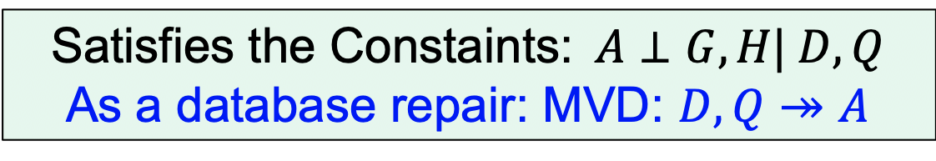
Causally Fair Prediction
Hobbies
Qualification
Admissible
Q
H
Q
The data D’ we want,
has this causal model
Inadmissible
G
D
A
Admitted
Gender
Dept
Our solution: repair D to a data D’ that we wish we had!
Satisfies the Constaints:$A⊥G,H\text{|} D,Q$
As a database repair: MVD: $D,Q↠$ $A$
Notes:
Can we instead adjust the data to account for the underling discrimination

Slide 72
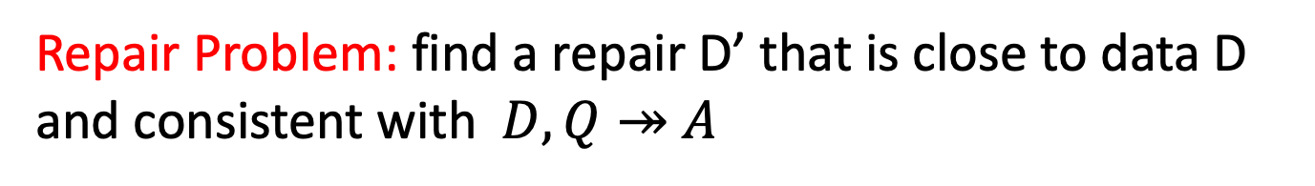
Causally Fair Prediction
Hobbies
Qualification
Admissible
Q
H
Q
Inadmissible
G
D
A
Admitted
Gender
Dept
Repair Problem: find a repair D’ that is close to data D and consistent with$D,Q↠$ $A$
Notes:
Can we instead adjust the data to account for the underling discrimination

Slide 73
Causally Fair Prediction
Hobbies
Qualification
Admissible
Q
H
Q
Inadmissible
G
D
A
Admitted
Gender
Dept
Repair Problem: find a repair D’ that is close to data D and consistent with$D,Q↠$ $A$
[MaxSAT and Low Rank Matrix Factorization]
Notes:
Can we instead adjust the data to account for the underling discrimination

Slide 74
Causally Fair Prediction
Hobbies
Qualification
Admissible
Q
H
Q
Inadmissible
G
D
A
Admitted
Gender
Dept
Repair Problem: find a repair D’ that is close to data D and consistent with$D,Q↠$ $A$
Theorem: any classifier trained using the repair D’ is causally fair even on unseen test data (under mild assumptions)
Notes:
Can we instead adjust the data to account for the underling discrimination

Slide 75
Experiment
[UCI Adult Census dataset ]
Source: Census bureau
Task: Discover high revenue people from census data. Two-class
Features: 14 attributes including age, occupation, education, marital status
Size: 48k rows
Repair Task: direct and indirect effect of Gender on Income via Marital Status
Details: Bias and accuracy measured using 5-fold cross validation (we ONLY repaired training data)
Notes:
The “adult” dataset from the UCI repository has records demographic information such as level of education and job related variables
job related variables occupation.
The objective is to learn a statistical model that predicts the class of income for a given individual. Suppose banks are interested in using this model to identify reliable candidates for loan application. Raw use of data might construct models that are biased towards females who are perceived to have lower income in general compared to males.
We used CAPUCHIN to remove the mentioned sources of discrimination from Adult
data.
Then, we trained the classifiers on both original and repaired training datasets using
the set of variables A [ N [ S.

Slide 76
Utility vs. Bias
Adult Data
14 attribute
48k rows
[UCI Adult Census dataset ]
Best is here
Bias quantifies discriminatory causal effects:
Gender-> Outcome
Gender->Marital Status->Outcome
Notes:
Explain the causal bias.
The graph compares the utility and bias of CAPUCHIN repair methods on Adult data. As shown, all repair methods
successfully reduced the ROD for all classifiers.
As you observed for bias is totally
Its not always as good as it. Size of the data, general accuracy of the classifier, data sparsity all matters
Residual bias is not statistically significant, in many groups is in favor of the minorities.

Slide 77
Utility vs. Bias
Adult Data
14 attribute
48k rows
[UCI Adult Census dataset ]
Best is here
Utility Reduction %2
Bias Reduction %98
Notes:
The graph compares the utility and bias of CAPUCHIN repair methods on Adult data. As shown, all repair methods
successfully reduced the ROD for all classifiers.
As you observed for bias is totally
Its not always as good as it. Size of the data, general accuracy of the classifier, data sparsity all matters
Residual bias is not statistically significant, in many groups is in favor of the minorities.

Slide 78
Capuchin vs. Others
Binned Adult Data
14 attribute
48k rows
[Fledman et. al. SIGKDD 2015]
[Calmon et. al., NIPS 2017]
They enforce Statistical Parity, e.g.,
P(Income=high | Male)=P(Income=high | Female)
Notes:
Both males and woman have the same probability of high income.
all methods significantly reduced ROD, even though the goal of Calmon’s and Fledman’s algorithm is essentially to reduce DP
We compared CAPUCHIN with two reference pre-processing algorithms, Feldman et al. [14] and Calmon et al. [7].
Feldman’s algorithm modifies each attribute so that the marginal distributions based on the subsets of the attribute with a given sensitive value are all equal. Calmon’s algorithm randomly transforms all variables except for the sensitive
attribute to reduce the dependence between training labels and the sensitive attribute subject to the following constraints:
(1) the joint distribution of the transformed data is close to the original distribution, and (2) individual attributes are not
substantially distorted. An example of a distorted attribute in the COMPAS dataset would be changing a felon with no
prior conviction to 10 prior convictions. Individual distortion is controlled for using a distortion constraint, which is
domain dependent and has to be specified for each dataset. and every single attribute. Note that both approaches are
designed to transform training and test data.

Slide 79
Capuchin vs. Others
”yellow is good, dark is bad”
[Fledman et. al. SIGKDD 2015]
[Calmon et. al., NIPS 2017]
Causal Bias
Statistical Parity
False Positive Balance
True Negative Balance
Notes:
CAPUCHIN reduced DP and other associational metrics
as a side effect. However, CAPUCHIN outperformed both methods in terms of utility

Slide 80
Causal Definitions of Fairness
Proxy fairness [Kilbertus et. al.]
Counterfactual fairness [Kusner et al.]
Same outcome for all values of proxy variables
Attempts to capture individual-level causality, which can’t be computed from observational data in general
Notes:
P(\hat{Y} | do(P=p)) = P(\hat{Y} | do(P=p'))
P( \hat{Y}_{S\leftarrow 0}(U) = 1| X = x,S = 1) = P( \hat{Y}_{S\leftarrow 1}(U)= 1| X = x;S = 1)

Slide 81
Ex: A discriminatory admissions process
Assume:
All variables binary
D, Q are uniform random: Pr(D) = Pr(Q) = 1/2
dpt A rejects all men and dpt B rejects all women
G
gender
Then
D
Y
Pr(Y = 1|do(G = 0),do(D = ’A’)) = 1/2
Pr(Y = 1|do(G = 1),do(D = ’B’)) = 1/2
department
admit
Unfair, but satisfies proxy fairness
Q
The admissions process is unfair at each department (and at individual-level)
But the unfairness effects cancel out at the population level.
qualifications
Notes:
\text{Pr}( \tilde{Y}_{S\leftarrow 0}(U) = 1| X = x,S = 1) = \text{Pr}( \tilde{Y}_{S\leftarrow 1}( U)= 1| X = x;S = 1)
P( \hat{Y}_{S\leftarrow 0}(U) = 1| X = x,S = 1) = P( \hat{Y}_{S\leftarrow 1}(U)= 1| X = x;S = 1)

Slide 82
Interventional K-Fairness
Babak Salimi
Luke Rodriguez
User specifies a set of admissible variables K
Don’t want to remove all effects of protected attribute, but want to be deliberate about which effects are allowed
An application is fair if the protected attribute does not affect the outcome for any possible configuration of (any superset of) admissible variables.
O is outcome
S is protected attribute
K is admissible variables
Ex: The admissions case does not satisfy interventional {D}-fairness

Slide 83
Problem: We don’t actually have a causal graph
Babak Salimi
Theorem: An application is interventionally K-fair if the Markov boundary of the outcome is a subset of the admissible variables
V is a Markov blanket of X iff
think nodes that “shield” X from the rest of the variables
MB(X) = parents(X) U children(X) U parents(children(X))
V is the Markov boundary of X if V is the minimal markov blanket
Key idea: Given the admissible variables K, we can derive a set of conditional independence constraints (CIs) that imply interventional K-fairness.
Then: Relate these CIs to database repair problems

Slide 84
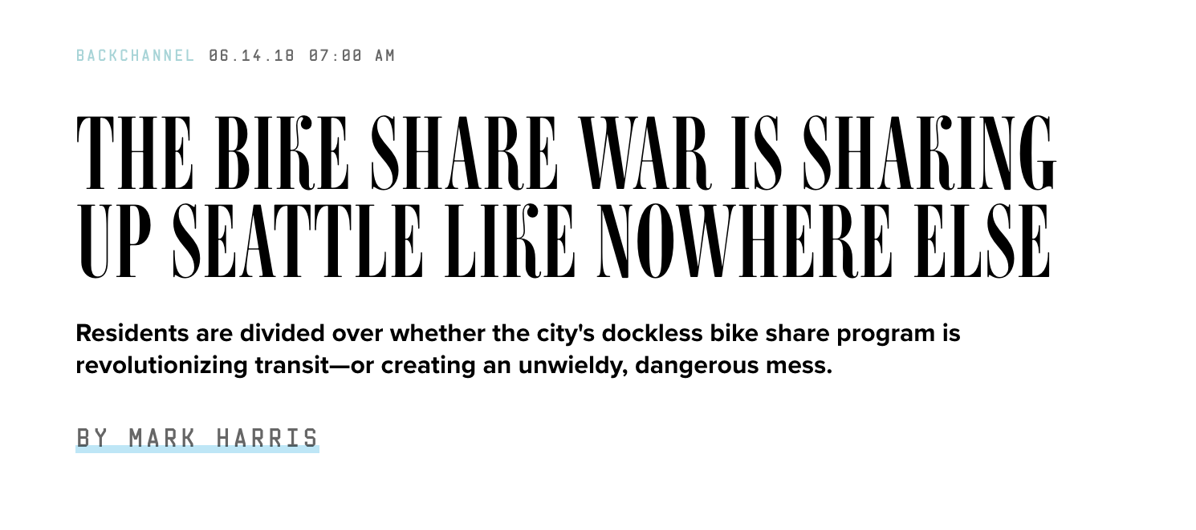
Example: Transportation Data
Example: Bike Share data
Babak Salimi
Luke Rodriguez

Slide 85
Example: Company -> Gender
Origin | Destination | Company | Gender
U District | U District | Bikes Inc. | Female
U District | U District | Bikes Inc. | Male
U District | U District | RideCorp | Female
U District | U District | RideCorp | Male
U District | Capitol Hill | Bikes Inc. | Female
Capitol Hill | U District | RideCorp | Female
Capitol Hill | U District | RideCorp | Male
38
43
47
39
15
13
7
…
Notes:
Running example – aggregated trips.
Change neighborhoods to Seattle neighborhood
This way we could see the bars getting closer in the length once we mitigate

Slide 86
Example: Company -> Gender
Origin | Destination | Company | Gender
U District | U District | Bikes Inc. | Female
U District | U District | Bikes Inc. | Male
U District | U District | RideCorp | Female
U District | U District | RideCorp | Male
U District | Capitol Hill | Bikes Inc. | Female
Capitol Hill | U District | RideCorp | Female
Capitol Hill | U District | RideCorp | Male
38
43
47
120
15
13
35
…
Notes:
Running example – aggregated trips.
Julia – it would help visually to replace the count column with a bar that shows the magnitude of the count – round to a 10 and round it
Change neighborhoods to Seattle neighborhood
This way we could see the bars getting closer in the length once we mitigate

Slide 87
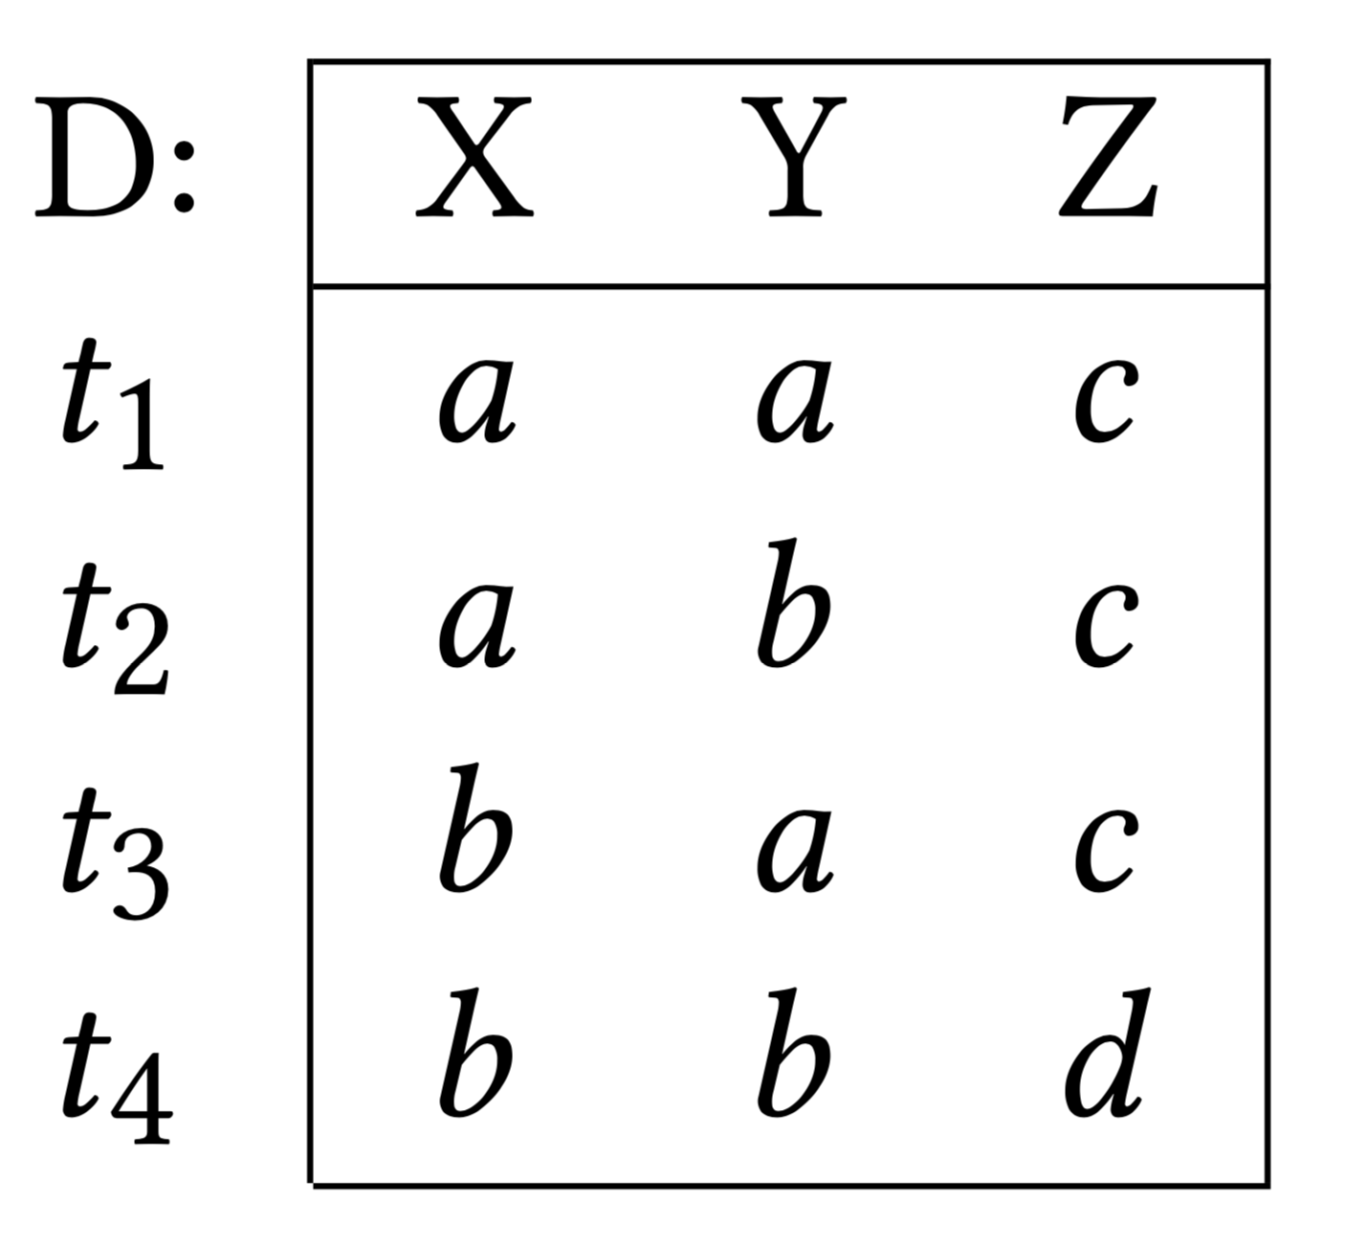
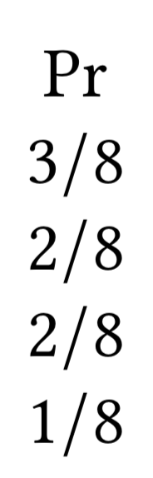
Given conditional independence constraints, derive
DB-style multi-valued dependencies (MVDs)
Does D satisfy
?
Delete a tuple
Insert a tuple
Consider probabilities to find a minimal repair

Slide 88
Example: Company and Gender
Origin | Destination | Company | Gender
U District | U District | Bikes Inc. | Female
U District | U District | Bikes Inc. | Male
U District | U District | RideCorp | Female
U District | U District | RideCorp | Male
U District | Capitol Hill | Bikes Inc. | Female
Capitol Hill | U District | RideCorp | Female
Capitol Hill | U District | RideCorp | Male
38
43
59
62
16
20
23
…
Notes:
Running example – aggregated trips.
Julia – it would help visually to replace the count column with a bar that shows the magnitude of the count – round to a 10 and round it
Change neighborhoods to Seattle neighborhood
This way we could see the bars getting closer in the length once we mitigate

Slide 89
Bias removed, utility preserved
Metric: rank order of the top-k histogram buckets via Kendall’s Tau
Idea: We care about the order of the high traffic head of the distribution, not the tail
Luke Rodriguez
95% confidence interval via bootstrap
very similar
very different
Seattle
Bikeshare
X = Company
Y = Gender
5
1.49
3.18
NYC
Taxi
X = Distance
Y = Tip
5
1.37
4.39
repaired dataset

Slide 90
The way I think about this…..(1)
First decade of Data Science research and practice:
What can we do with massive, noisy, heterogeneous datasets?
Next decade of Data Science research and practice:
What should we do with massive, noisy, heterogeneous datasets?
Notes:
On which projects should we engage?
How can we ensure fairness, accountability, and transparency for algorithmic decision-making?
How do we ensure privacy?
How do we avoid junk science?

Slide 91
The way I think about this…. (2)
Decisions are based on two sources of information:
1. Past examples
e.g., “prior arrests tend to increase likelihood of future arrests”
2. Societal constraints
e.g., “we must avoid racial discrimination”
We’ve become very good at automating the use of past examples
We’ve only just started to think about incorporating societal constraints

Slide 92
The way I think about this… (3)
How do we apply societal constraints to algorithmic decision-making?
Option 1: Keep a human in the loop
Ex: EU General Data Protection Regulation requires that a human be involved in legally binding algorithmic decision-making
Ex: Wisconsin Supreme Court says a human must review algorithmic decisions made by recidivism models
Option 2: Build them into the algorithms themselves
I’ll talk about some approaches for this

Slide 93
The way I think about this…(4)
On transparency vs. accountability:
For human decision-making, sometimes explanations are required, improving transparency
Supreme court decisions
Employee reprimands/termination
But when transparency is difficult, accountability takes over
medical emergencies, business decisions
As we shift decisions to algorithms, we lose both transparency AND accountability
“The buck stops where?”

